Slide 1

Hawk Migration Association
The
North America
of

Slide 2
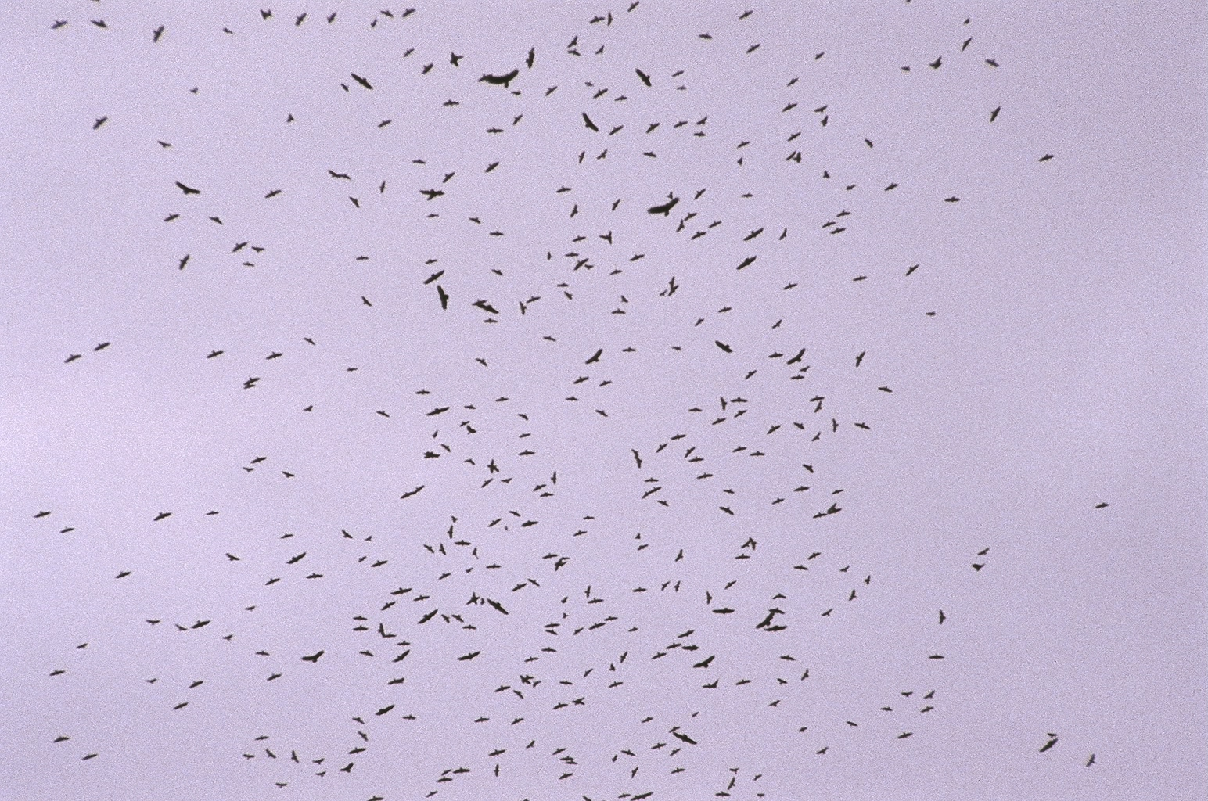
Potomac Valley Audubon
Advanced Birding Workshop
Raptor Identification
Species of the Northeast
For HMANA
©Susan Fogleman, producer
Copyright 2008

Slide 3
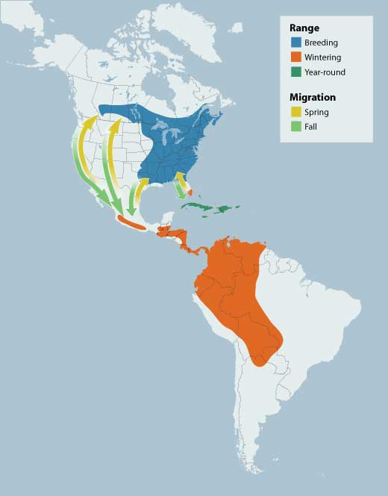
Raptor Migration
Map:
e.g. Broad-winged Hawk
Spring:
March-May
Fall:
mid-August to early October
mid-Atlantic peak: Sept 15-20
95% pass in a two week period
Only 12% are found alone
Raptor Peak Times (Fall – mid Atlantic):
Sept - Osprey
Bald Eagle
Broad-winged Hawk (mid)
American Kestrel (late)
Oct – Northern Harrier
Sharp-shinned Hawk (early)
Peregrine Falcon (early)
Merlin (early)
Red-shouldered Hawk (mid)
Cooper’s Hawk (mid)
Nov – Golden Eagle
Bald Eagle
Northern Goshawk
Red-tailed Hawk (early)
Notes:
Most beginning hawkwatchers rely heavily on the standard field guides to bird identification. However, field marks such as color and wing markings are not always viewable on hawks passing a watchsite. This can be a result of many factors such as distance, bright sky, and backlighting.
In this program field marks will be referred to from time to time, but our main intent is to familiarize the viewer with the more “gestalt” aspects of raptor identification. The purpose of the field mark slides is to show any aspects of a bird that might be seen which would add a degree of confidence to an identification

Slide 4
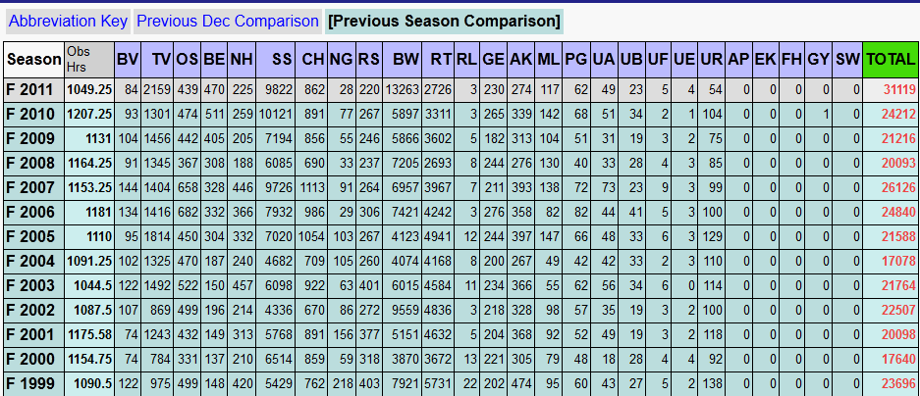
Hawk Watching Sites
Data from: Hawkcount.org
Waggoner’s Gap – Near Carlise, PA
Notes:
Most beginning hawkwatchers rely heavily on the standard field guides to bird identification. However, field marks such as color and wing markings are not always viewable on hawks passing a watchsite. This can be a result of many factors such as distance, bright sky, and backlighting.
In this program field marks will be referred to from time to time, but our main intent is to familiarize the viewer with the more “gestalt” aspects of raptor identification. The purpose of the field mark slides is to show any aspects of a bird that might be seen which would add a degree of confidence to an identification

Slide 5
Identification
How can you know what you are seeing?
By Using General Impressions:
  SHAPE
  SIZE
  BEHAVIOR
Notes:
Most beginning hawkwatchers rely heavily on the standard field guides to bird identification. However, field marks such as color and wing markings are not always viewable on hawks passing a watchsite. This can be a result of many factors such as distance, bright sky, and backlighting.
In this program field marks will be referred to from time to time, but our main intent is to familiarize the viewer with the more “gestalt” aspects of raptor identification. The purpose of the field mark slides is to show any aspects of a bird that might be seen which would add a degree of confidence to an identification

Slide 6
Notes:
Pictured here is a mixed-species kettle photographed at Cardel, Veracruz, MX.
In addition to the circled hawk, a number of Turkey Vultures are evident.

Slide 7
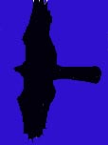
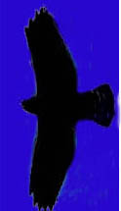
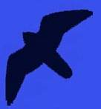

First!
Learn the basic silhouettes/shapes of…
Accipiters
Buteos
Falcons
Eagles

Slide 8
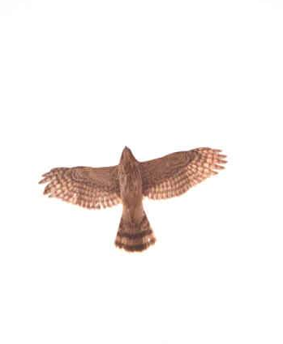
Accipiters
are forest-dwelling hawks
Built for rapid flight and lightning quick turns in wooded habitats
Characterized by short, rounded wings and long, narrow tail
In migration or in open habitat they exhibit intermittent flapping and gliding flight

Slide 9
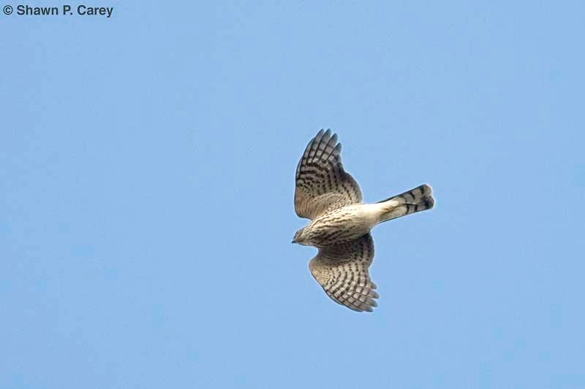
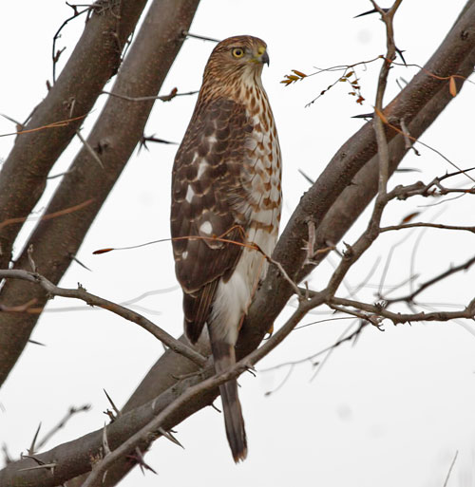
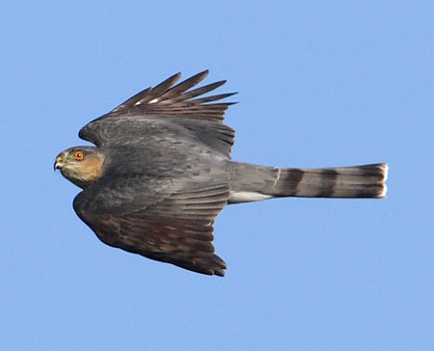
Sharp-shinned Hawk
the smallest Accipiter
Blue Jay sized
Small-ish head
barely projects
beyond “wrists”
Short, rounded wings
Tail usually appears
square-ish, sometimes
with a notch

Slide 10
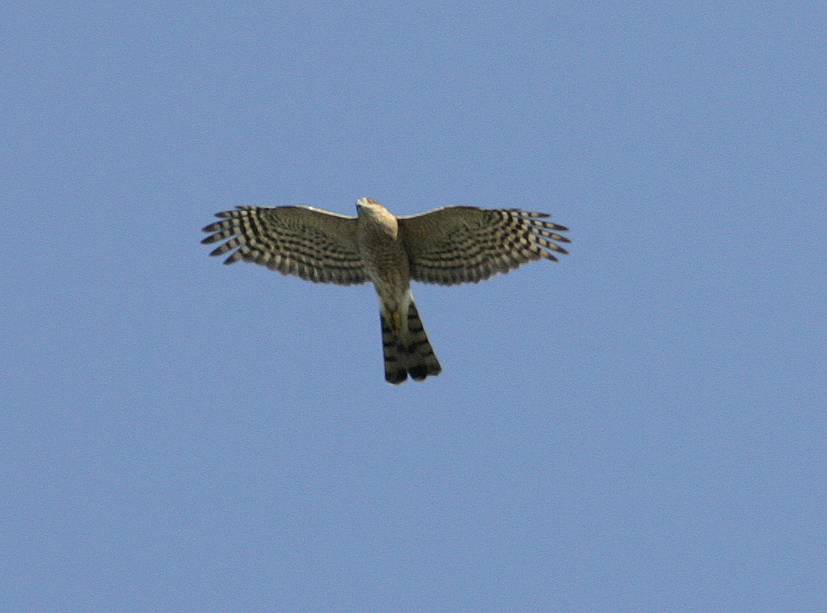
Wingbeat:
Snappy
Deep
Rapid (hard to count)
“flippity flippity flippity … glide”

Slide 11
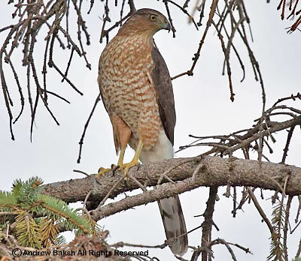
Cooper’s Hawk
medium-sized Accipiter
Short-ish, rounded wings
Straight leading edge of
wing
Protruding head
Long, usually rounded tail
Notes:
The Cooper’s Hawk pictured here is an immature. Adults have rust-colored barred underparts.

Slide 12
Wingbeat:
Stiff
Shallow
Slower
“flappa
flappa
flappa …
glide”

Slide 13
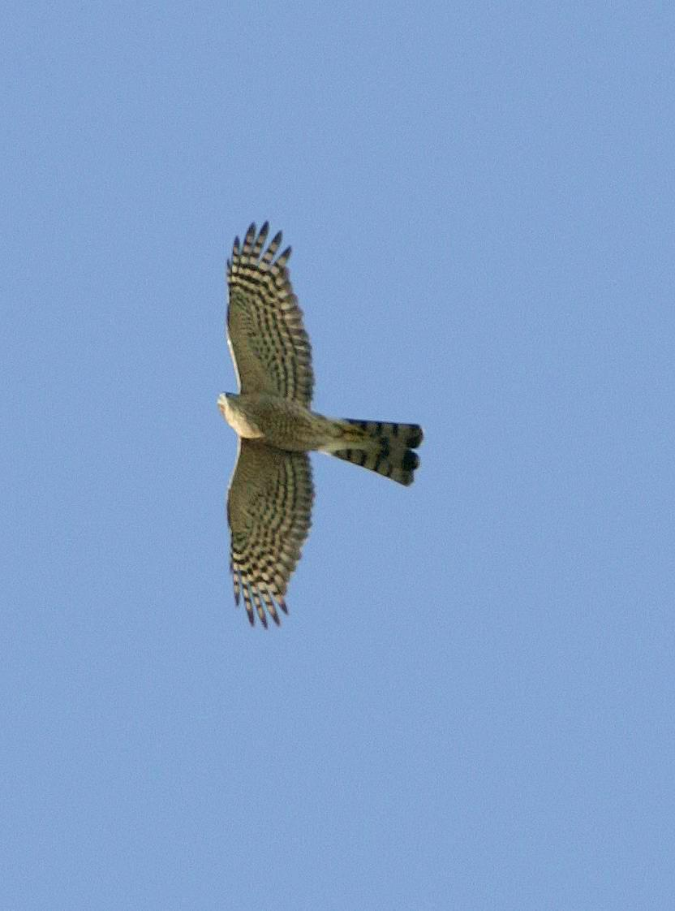
Has a longer-”feeling” appearance
than the Sharp-shinned
Sharp-shinned
Cooper’s
Small head
Protruding
head
Rounded tail
Square-ish tail,
(sometimes notched)
A flying “T”
A flying cross
Notes:
Both of these birds are immatures.

Slide 14
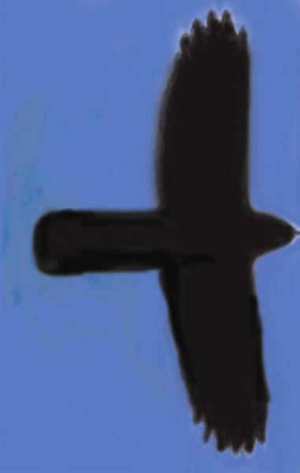
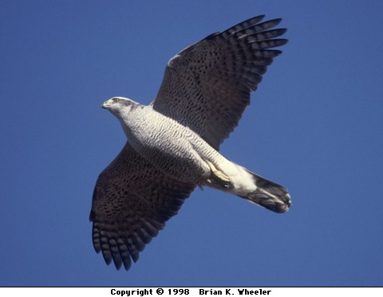
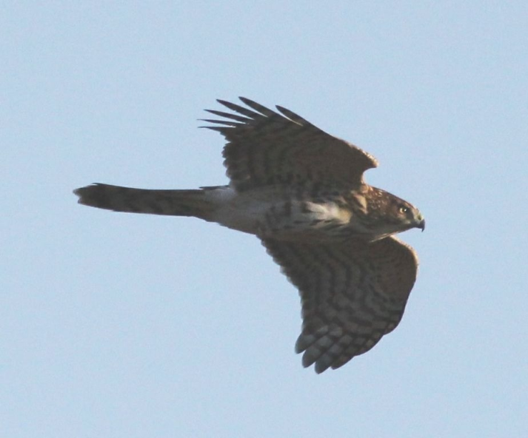
Northern Goshawk
largest Accipiter
Short-ish (comparatively),
rounded wings
Long, heavy-looking tail
“Chunky” cylindrical body
Deep, heavy wingbeat
Notes:
No clear pictures of adult Goshawks in flight could be found for this program. Many of the donors of photographs as well as other contacts said, “They’re on us before we know it, and then it’s too late to catch them!”
This is a testament to the fact that Goshawks can cover a lot of distance with each powerful flap of wings. As the late expert hawkwatcher Robert Smart once said, “Sharpies fly ‘flippy flippy flippy ---- glide. Coops fly ‘flappa flappa flappa ----gli-i-de.’ And Goshawks fly ‘FLOMpa FLOMpa FLOMpa gli-i-i-ide.’”

Slide 15
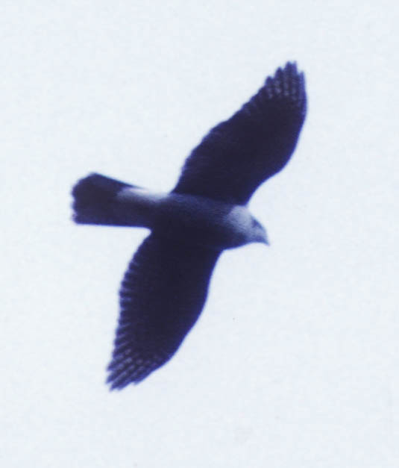
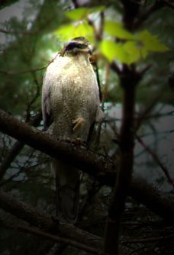
Sometimes the distinctive
dark “eye-stripe” and white
“eyebrow” (superciliary line)
can be seen if the bird is
close enough
Notes:
No field marks visible on this “blown-up” shot of an overhead Gos, and yes, that shot does look fuzzy. This is a good example of exactly how one might see this species in migration, and why knowledge/familiarity with shape and behavior is so important.

Slide 16
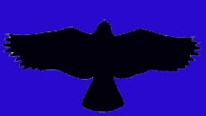
Buteos
are soaring hawks
Designed to utilize air currents
to minimize flapping
Generally found in more open areas
Characterized by long, wide wings and
relatively short broad tail
Perfect form for utilizing updrafts and thermals

Slide 17
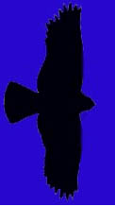
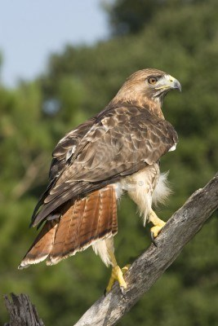
The Quintessential Buteo:
Red-tailed Hawk

Slide 18
Red-tailed Hawk
Comma
Square-ish wing tips
Belly band
Adults have
brick red tail
Juveniles’ tails
are faintly barred
and brown
Dark patagial area
Notes:
“Belly band” is noted in this slide, but it is important to know that belly bands on Red-tailed Hawks can vary from very dark and dense to only a few barely discernable speckles.
This sub-adult Red-tail shows some faint barring in the tail, which is beginning to show the rusty red of an adult. Younger Red-tails exhibit faintly barred brownish tails.

Slide 19
But…
What if I can’t see those markings?

Slide 20
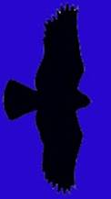
Remember the silhouettes?
And don’t forget behavior…

Slide 21
For example, notice on this silhouette:
Red-tailed
“Bulging” secondaries
Relatively short tail

Slide 22
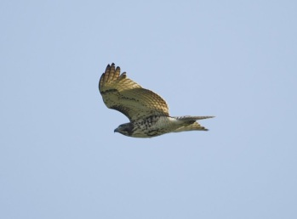
What do you notice about this bird?
It is soaring…
It is a Buteo…
It seems to have bulging secondaries...
Hmmm… its wings seem to be in a slight dihedral (held above horizontal)

Slide 23
This is what a dihedral looks like
when a hawk is coming toward you.
It is also what it looks like when a
hawk is going away from you!

Slide 24
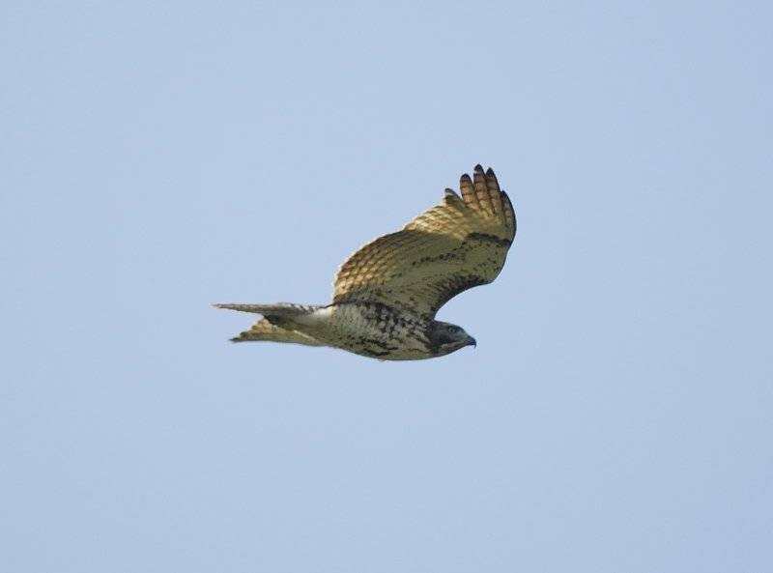
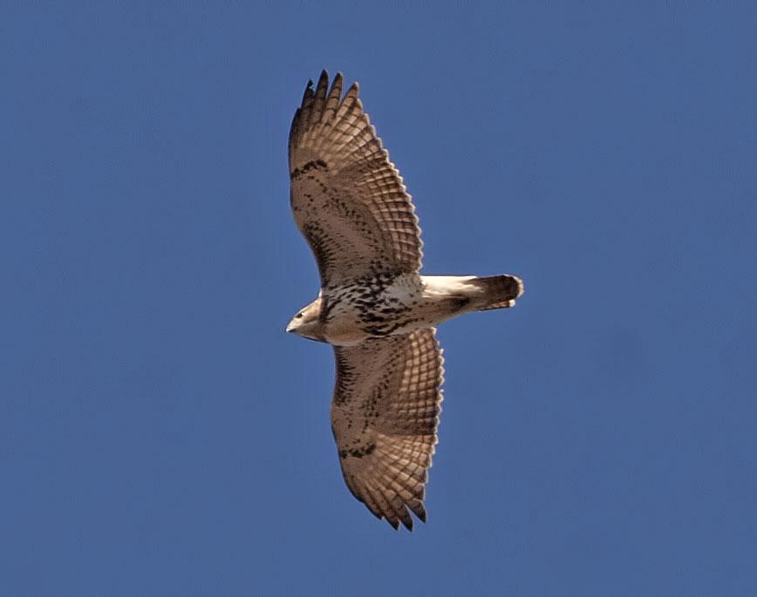
Red-tailed Hawks generally soar with their wings held…
…in a slight dihedral
When Backlit, “windows” can be seen…

Slide 25

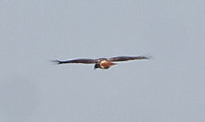
Top or bottom view
End view
Basic Red-tailed flight profiles

Slide 26
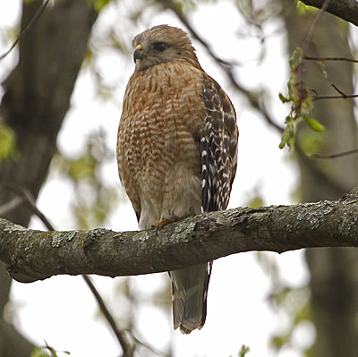

Red-shouldered Hawk
mid-sized Buteo
Flaps wings a bit more
than other Buteos do
Proportionately longer tail
Wings reach forward
while soaring
White “crescents”
along base of primaries
(visible from top or bottom)
Narrow white tail-bands
Notes:
Red-shouldered Hawks seem “hyper” compared to other Buteos. They can sometimes give an Accipiter-like impression because of this behavior and their longer tails. When a Red-shoulder is soaring in an updraft it does indeed flap more and makes frequent wing-adjustments.
The tail appears longer compared to Red-tails. This is because the Red-shoulder’s wings are narrower next to the body than are those of the Red-tail. Seasoned watchers refer to tail-length in terms of its relation to the depth of the wing
1
1.5

Slide 27
Top or bottom view
Incoming or
End view
Bowed
Basic Red-shouldered flight profiles
Notes:
The end-view profile is shown as flat here, but Red-shoulders’ wings in a glide can also be slightly bowed.

Slide 28
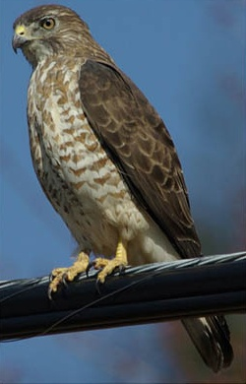
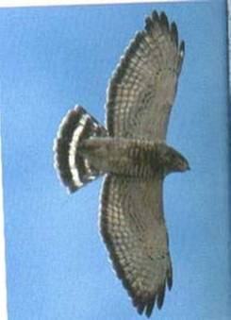
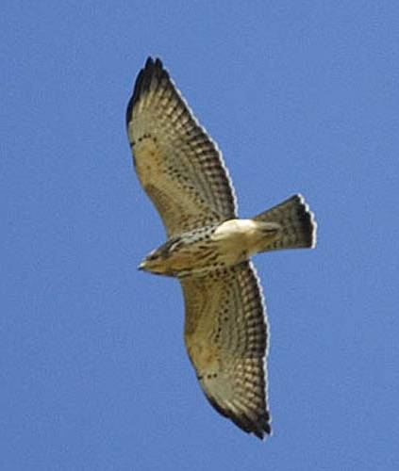
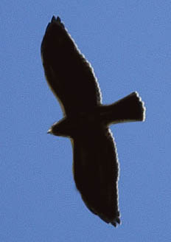
Broad-winged Hawk
Chunky, crow-sized Buteo
“Flame-shaped” wing
held straight out from body
Wide, white tail bands
Pale under-wing with
black trailing edge

Slide 29
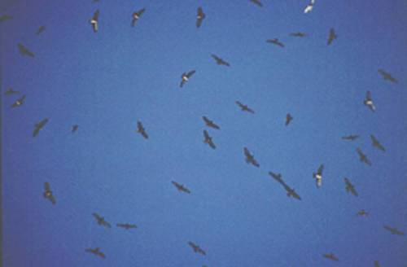
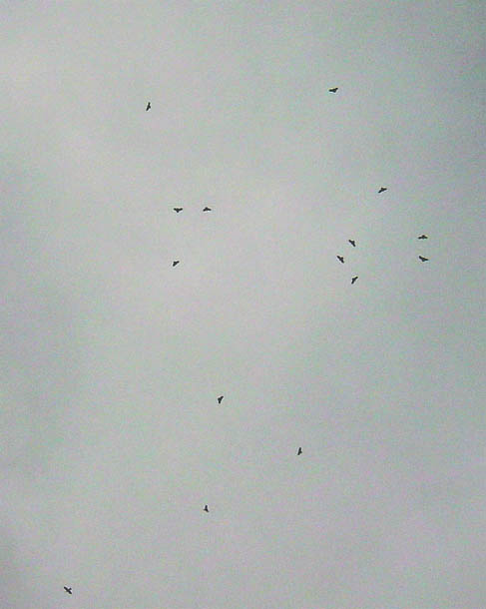
Flocks (“kettles”) during migration

Slide 30
Top or bottom view
Incoming view
Slightly bowed
End view
Basic Broad-winged flight profiles

Slide 31
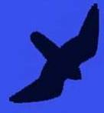
Falcons
are fast-moving raptors
Have a “sickle” shape
Long pointed wings
Long-ish tail
Rarely soar
(Peregrines and Kestrels sometimes do in migration)

Slide 32
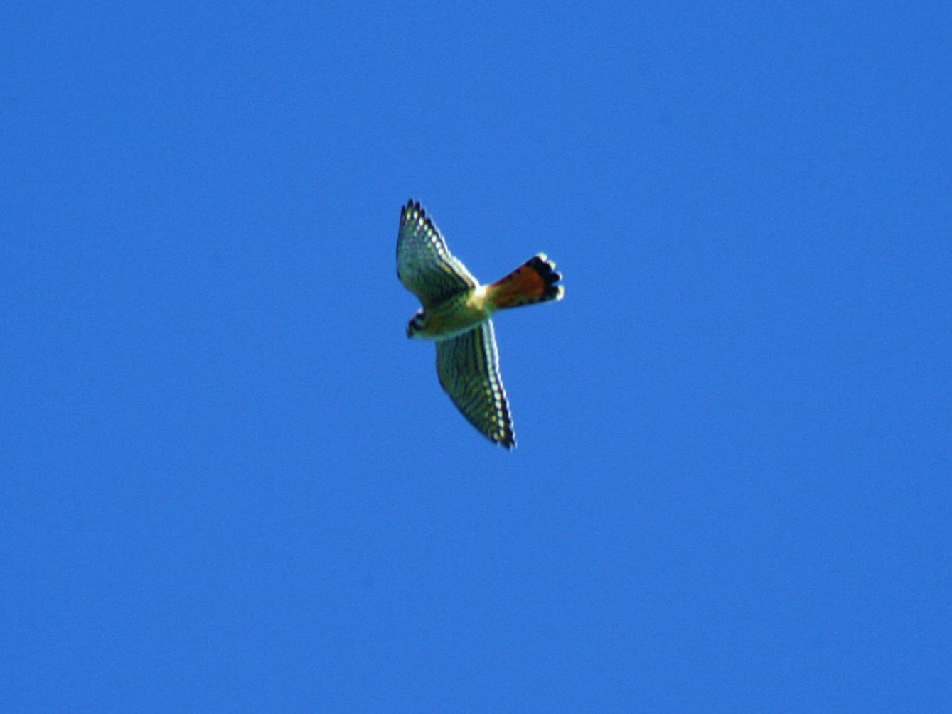

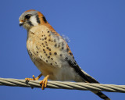
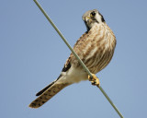
American Kestrel
our smallest falcon
Males
and females
are dimorphic (differ in plumage)

Slide 33
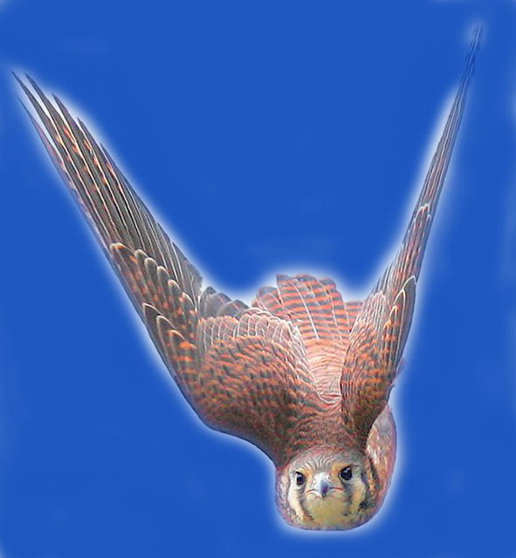
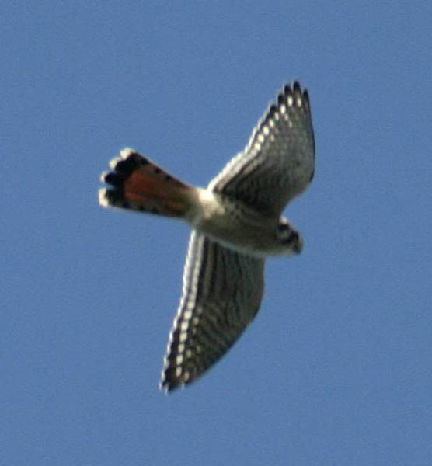
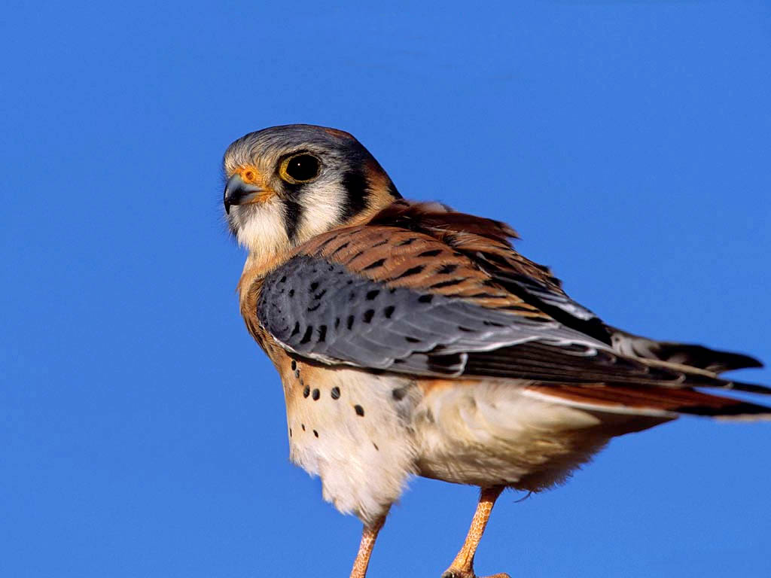
Female
Has a more subtle rufous back
And numerous narrow bands in tail
Male
Has bright rufous
back and blue-ish wings
With a single dark band at end of tail

Slide 34
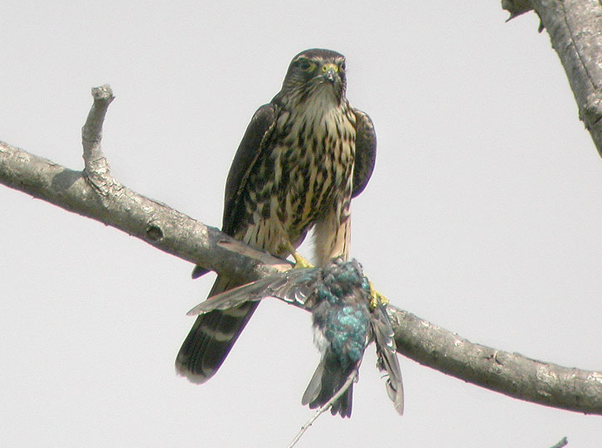
Merlin
Just a little bigger than the Kestrel
A small, FAST falcon…
Powerful, flapping flight
Shallower and faster than the Kestrel

Slide 35
Wider wings than American Kestrel
Merlins have dark plumage
Like the Kestrel, they are
dimorphic
Males are dark grey
Females and young are
heavily streaked and
chocolate brown
(Note the Checkerboard pattern)

Slide 36
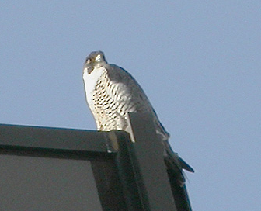
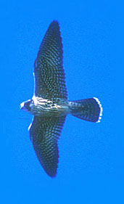
Peregrine Falcon
a larger falcon
Very long, pointed wings
Powerful, deep flaps
Fast flight

Slide 37
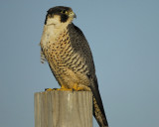
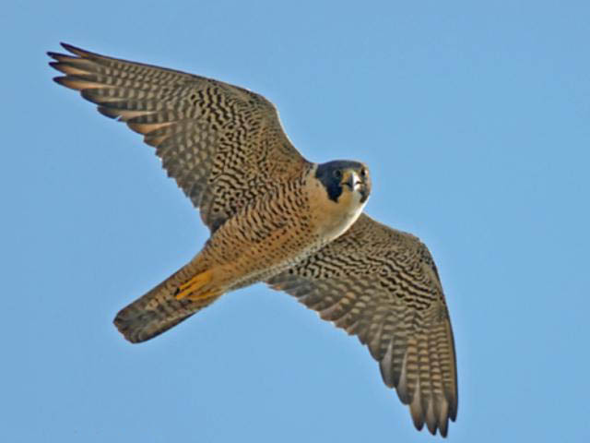
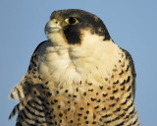
White upper breast
and throat…
…can usually be seen in flight
Dark cheek (moustachial) patch

Slide 38

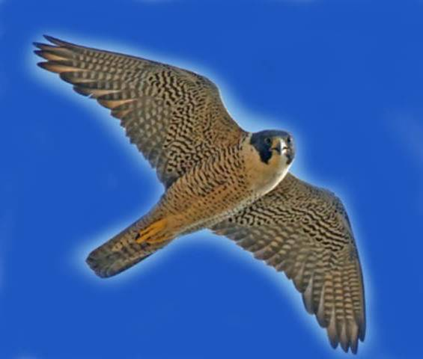
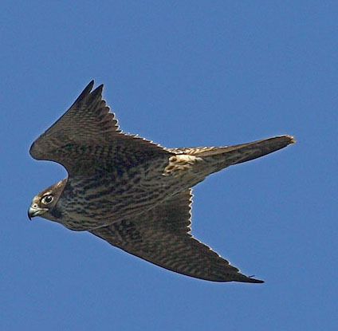
Adult has grey barring on breast
and dark, heavy barring on underwing
Immature has brown streaking

Slide 39
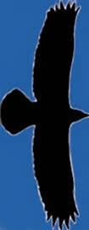
Eagles
Very large soaring birds
With 6–7 foot wingspans

Slide 40
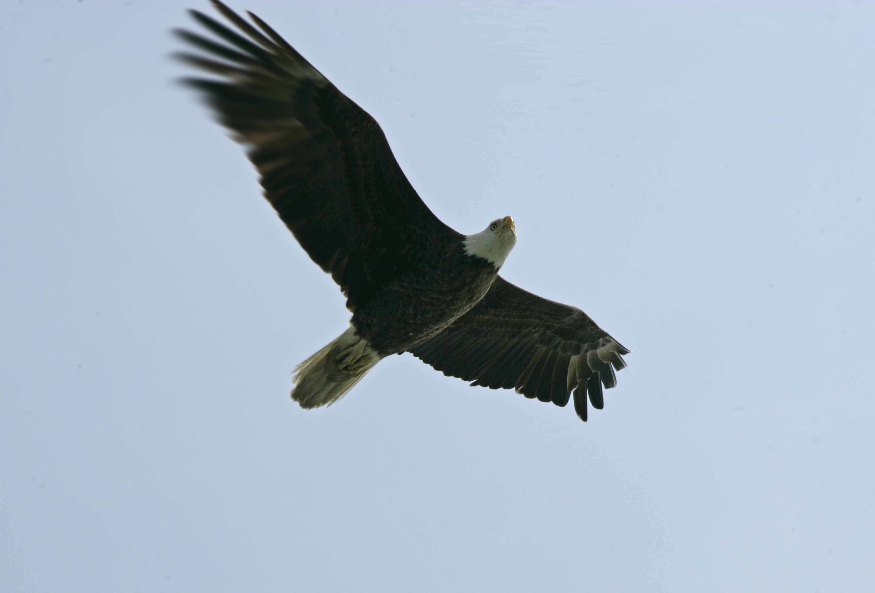
Bald Eagle

Slide 41



Large protruding head and bill
Long straight wings held flat when soaring

Slide 42



Immature Bald Eagles
Are brown and can
cause confusion with
other large birds…
It takes 5 years to reach
adult plumage
White can be anywhere,
mottled and blotchy
  White in ‘wingpit’ area
Also, on belly and along line of wing

Slide 43


Golden Eagle
Large, dark soaring bird

Slide 44

Golden Eagle
Smaller head
projection than
Bald Eagle
Tail appears
longer
Has a touch of
secondary bulge
Holds wings flat
or at a moderate
dihedral
Maintains a
steady flight

Slide 45
Golden Eagles
Have “golden” feathers on the nape
Note: slight dihedral
Note: long-ish tail
and relatively small head

Slide 46


Immature Golden Eagles
Have white patches typically restricted to base of tail and center of wing

Slide 47
Are you an eagle-eye?
QUIZ time!

Slide 48


Who’s who?

Slide 49


Which youngster is which?

Slide 50
Questions to ask yourself:
Small head projection?
Large head projection?
Blotchy white? or White patches?
A “plank?” A dihedral?

Slide 51


Hey!
What kind of hawk is that?
It is a big bird, and it often soars.
But – note the head.
NOT a hawk, but often seen at watch sites
It’s a… Raven
Ravens are seldom alone; they flap more than hawks with a strong rowing wingbeat
Notes:
Soaring Ravens catch the eye of hawkwatchers time and again. Knowing their silhouette and behavior can save a lot of time trying to figure out “what kind of hawk” it might be. The sooner one realizes the bird in question is a Raven the sooner one can return to looking for actual raptors!

Slide 52


Osprey
A very distinctive shape
A
shaped profile
White belly and head
Dark carpal (“wrist”) patches
Dark eye-line

Slide 53



Females have “necklaces”
Ospreys always show a crook in the wing
This is a male
Notes:
There actually is some overlap in the amount of “necklace” streaking. However, birds with heavier streaking are usually females, and birds with none are males. (Clark and Wheeler, 2001)

Slide 54

And this is how you often see them
Going away it’s a

Slide 55


Northern Harrier
Long narrow wings
3-4 foot wingspan
Long tail
Slender body
Distinct dihedral
Clear rectangular
white rump patch
*Note: Other raptors
will also appear to have a
white rump depending on Sun
angle

Slide 56



Females have belly streaking and young birds are “buffy looking”
Both are brownish…
Adult males are silvery:
Grey above and white-ish
below with black wing tips
The “Grey Ghost”
Notes:
Female underparts are heavily streaked, whereas streaking on young birds is limited to upper breast and flanks.

Slide 57


Both genders display
the white rectangular
rump patch…

Slide 58



A circus of
Harriers
Notes:
The scientific name for Northern Harrier is Circus cyanus.

Slide 59

Turkey Vulture
…a very large bird
Floats through the air with wings in a pronounced dihedral
Often rocks from side to side

Slide 60


Turkey Vultures have contrasting colors on underside of wings
Flight feathers are silvery-grey from body out to the wingtips
Notes:
Flight feathers = primaries and secondaries

Slide 61

Black Vulture
Has square-ish white patches at the wingtips
Looks “stubby” due to wide wings and short tail

Slide 62


Let’s compare…
Turkey Vulture
Black Vulture
Long wings
Pale flight feathers
Held in dihedral
Rocking flight
Longish tail
Broad wings
Ending in white patches
Flatter flight profile
Flaps more rapidly
Stubby appearance

Slide 63



Swainson’s Hawk
Long-winged Buteo of the prairies
• Dark bib,
sometimes split
• Pale wing-pits
• Dark flight feathers
Wings held in dihedral
Notes:
Flight feathers = primaries and secondaries

Slide 64


Mississippi Kite
A southerner edging northward
Grey in color
Very swift and graceful
floating flight
Often seen catching
insects on the wing
Falcon-like shape, but
narrower wings

Slide 65

Possible winter visitors
In wide open habitats
A Buteo
and
a Falcon

Slide 66



Rough-legged Hawk
Long winged Buteo from the north
Dark
and
Light color morphs
Light morphs show a
dark belly and
dark wrist (carpal) patch
Broad white sub-terminal tail band
(Both morphs)

Slide 67


Gyrfalcon
The largest falcon
Bird of the tundra
Rare visitor south
of the Canadian border
Colors range from white
through dark grey

Slide 68
Remember this picture?
Remember the question?
Now imagine you are using your binoculars

Slide 69



What do you see?

Slide 70
If you said
Broad-winged Hawk
you were correct!

Slide 71














2
1
3
Final exam time!
4
5
6
7
8
9
10

Slide 72





The Answers:
Red-shouldered Hawk
Black Vulture
Osprey
American Kestrel
Bald Eagle (immature)
Peregrine Falcon
Sharp-shinned Hawk
Red-tailed Hawk
Cooper’s Hawk
Broad-winged Hawk

Slide 73
Caveats
Now that you know all the answers(:> and feel ready to get to your local hawk watch to ID everything that flies overhead…
Keep the following in mind:
Birds change shape depending upon winds, light and the angle of view

Slide 74


A falcon in a glide may spread its tail to soar on a thermal

Slide 75


A buteo straight overhead make look very different when seen at an angle

Slide 76
A Few Final Points
Nobody is right 100% of the time
For every rule, there is an exception
(Ex.: a Sharp-shinned hawk with a rounded tail)
Every bird teaches something –
Once you’ve ID’ed it, stay with it, see how it moves, changes shape, how it looks at different angles

Slide 77
Tools for Hawk Identification
Hawk Field Guides:
Clark, W. and B. Wheeler. Hawks Peterson series.
Dunne, P., D. Sibley, C. Sutton. Hawks in Flight Houghton Mifflin Co.
Liguori, J. Hawks from Every Angle, Hawks from a Distance Princeton Univ. Press
Wheeler, B. Raptors of Eastern N.A. Princeton Univ. Press.
Wheeler, B.K. and W. Clark. A photographic guide to N.A.
Raptors Academic Press.
Video:
Hawk Watch, a video guide to Eastern Raptors R.K Walton & G. Dodge

Slide 78
Raptor Web Site Resources
Hawk Migration Association of North America (HMANA):
www.hmana.org
Raptor Population Index:
rpi-project.org
Hawk Counts:
hawkcount.org
Conservation Status of North American birds of prey:
rpi-project.org/publications/TP-07.pdf
This Presentation:
wvbirder.org/recent/RaptorsMB

Slide 79

All photographs are protected by copyright law
Permission for use outside of this program is prohibited without permission of the photographer or provider
Photos from:
Vic Berardi
Shawn Carey
Kate Davis
Ken Dudzik, USFS
Susan Fogleman
Wavell Fogleman
Angel Karedes, USFS
Joseph Kennedy
David McNicholas
Rob Palmer
Brian Wheeler
Matt Orsie

Slide 80



Copyright 2008 all rights reserved

