Slide 1
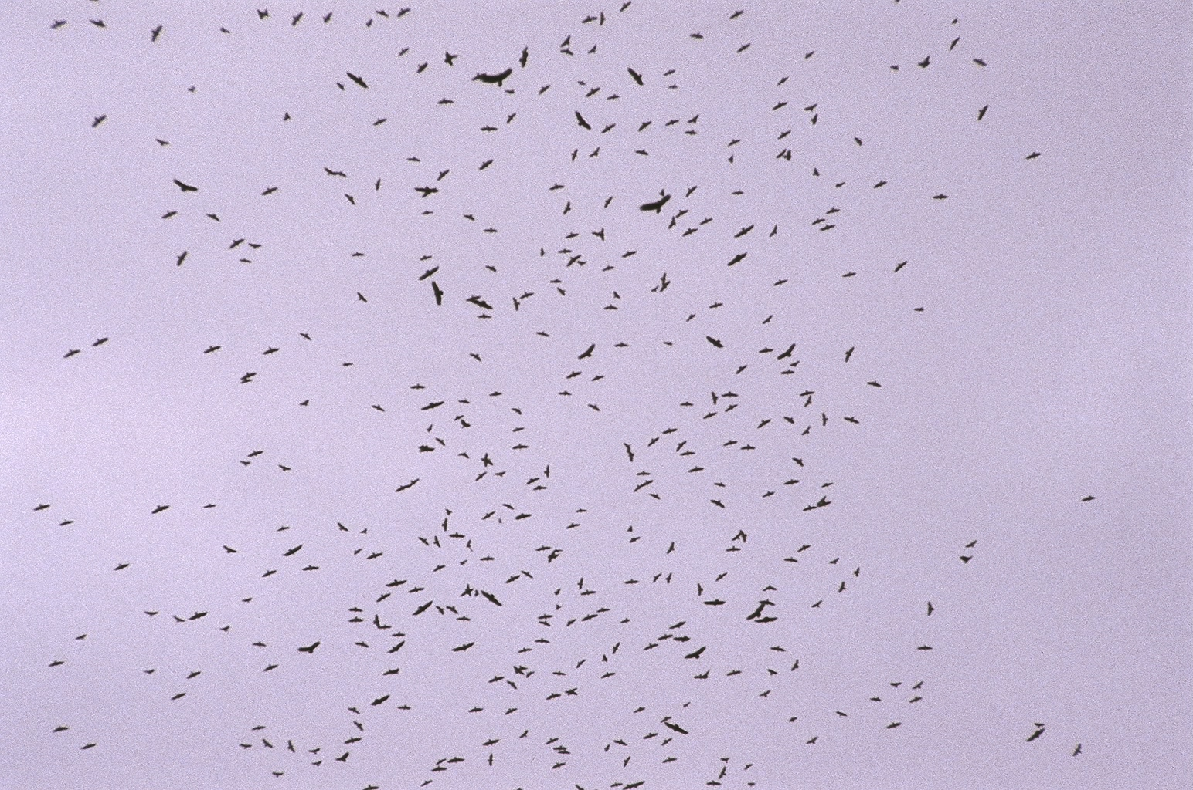
Mountaineer Audubon
Raptor Identification
In Flight
Species of the Northeast
Presented by Matt Orsie

Slide 2
Identification
How can you know what you are seeing?
By Using General Impressions:
  SHAPE
  SIZE
  BEHAVIOR
Notes:
Most beginning hawkwatchers rely heavily on the standard field guides to bird identification. However, field marks such as color and wing markings are not always viewable on hawks passing a watchsite. This can be a result of many factors such as distance, bright sky, and backlighting.
In this program field marks will be referred to from time to time, but our main intent is to familiarize the viewer with the more “gestalt” aspects of raptor identification. The purpose of the field mark slides is to show any aspects of a bird that might be seen which would add a degree of confidence to an identification

Slide 3
Notes:
Pictured here is a mixed-species kettle photographed at Cardel, Veracruz, MX.
In addition to the circled hawk, a number of Turkey Vultures are evident.

Slide 4
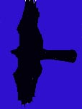
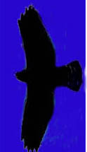
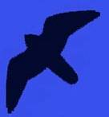

First!
Learn the basic silhouettes/shapes of…
Accipiters
Buteos
Falcons
Eagles

Slide 5
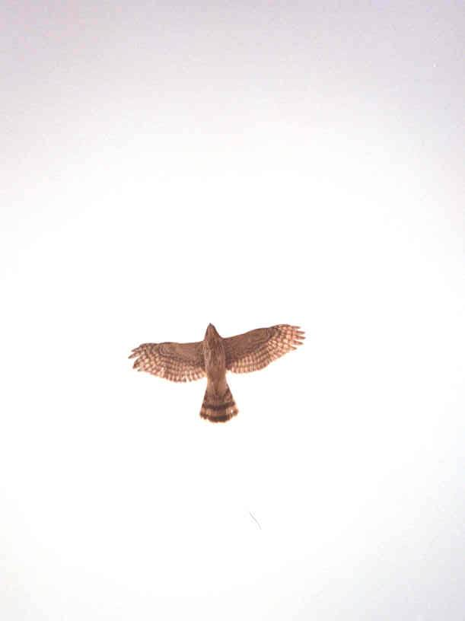
Accipiters
are forest-dwelling hawks
Built for rapid flight and lightning quick turns in wooded habitats
Characterized by short, rounded wings and long, narrow tail
In migration or in open habitat they exhibit intermittent flapping and gliding flight

Slide 6
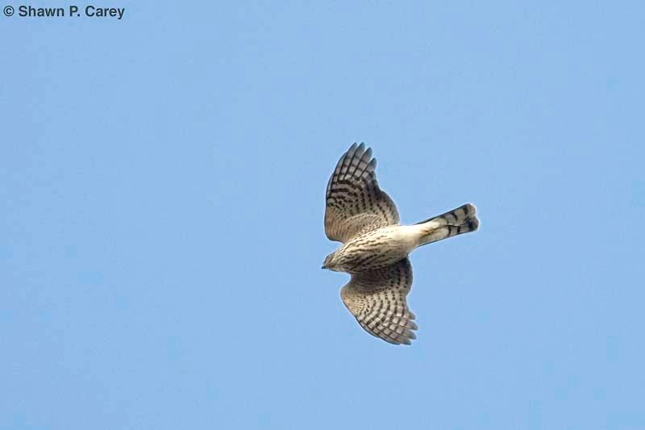
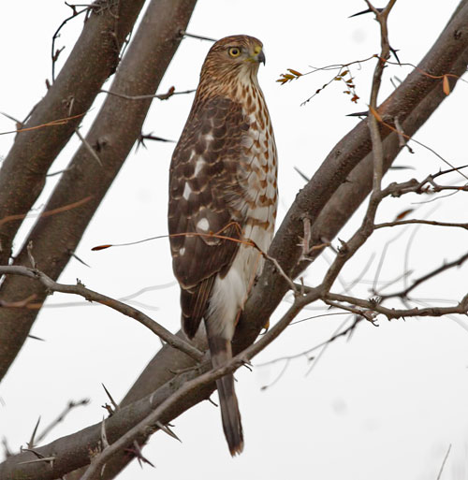
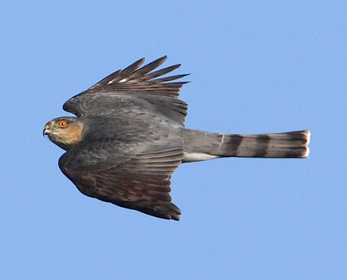
Sharp-shinned Hawk
the smallest Accipiter
Blue Jay sized
Small-ish head
barely projects
beyond “wrists”
Short, rounded wings
Tail usually appears
square-ish, sometimes
with a notch

Slide 7
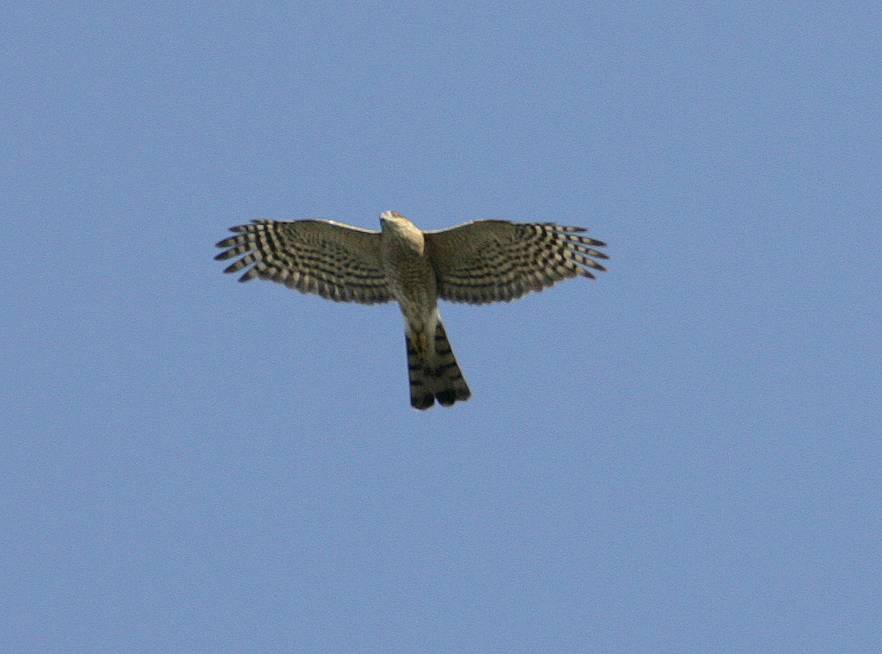
Wingbeat:
Snappy
Deep
Rapid (hard to count)

Slide 8
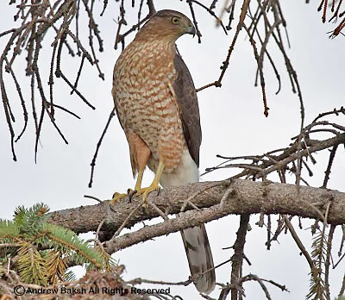
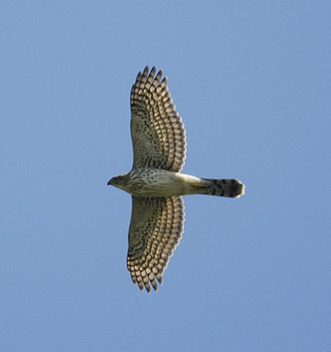
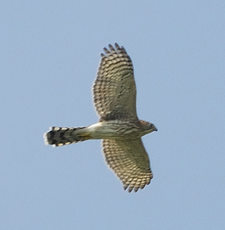
Cooper’s Hawk
medium-sized Accipiter
Short-ish, rounded wings
Straight leading edge of
wing
Protruding head
Long, usually rounded tail
Notes:
The Cooper’s Hawk pictured here is an immature. Adults have rust-colored barred underparts.

Slide 9
Wingbeat:
Stiff
Shallow
Slower
(than Sharp-shinned)

Slide 10
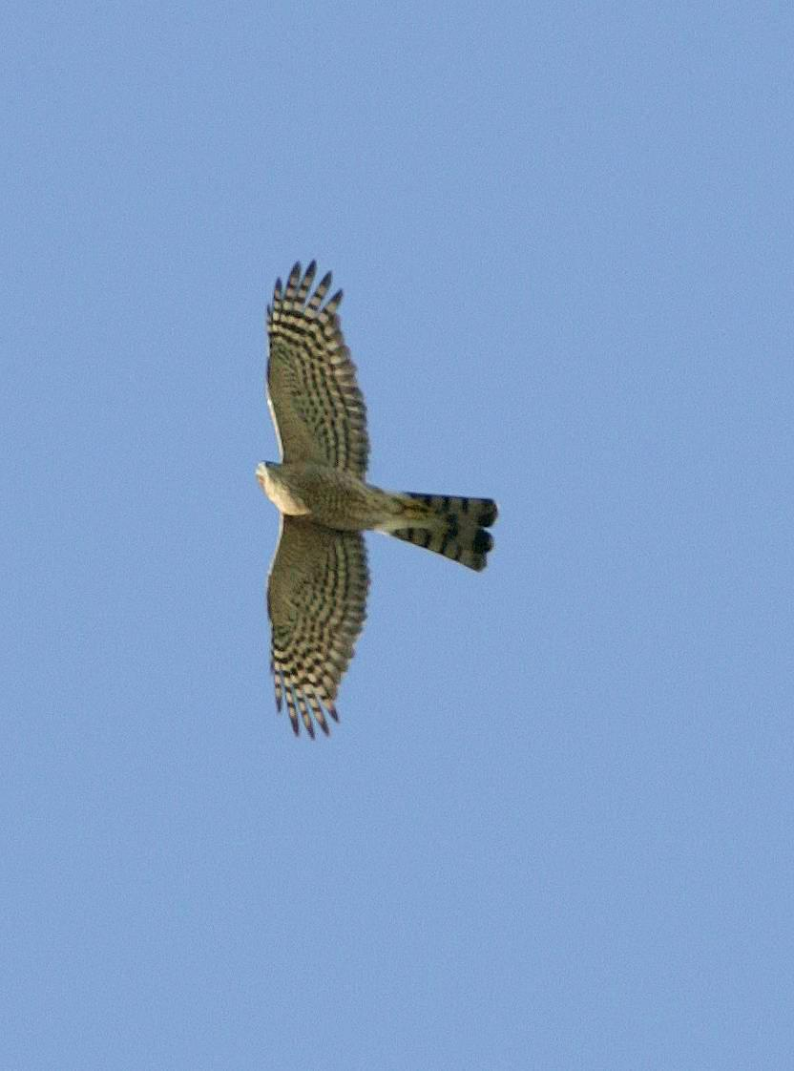
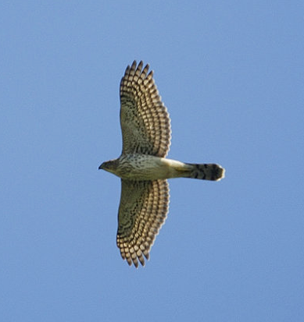
Has a longer-”feeling” appearance
than the Sharp-shinned
Sharp-shinned
Cooper’s
Small head
Protruding
head
Rounded tail
Square-ish tail,
(sometimes notched)
A flying “T”
A flying cross
Notes:
Both of these birds are immatures.

Slide 11
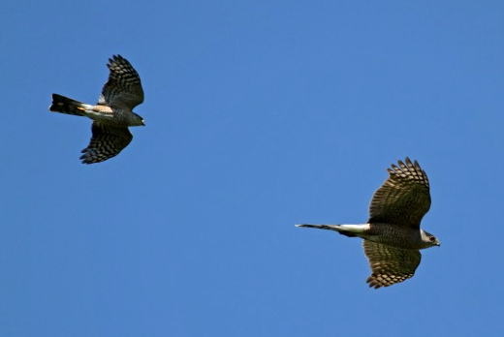
In Flight Comparison
Jay McGowan

Slide 12
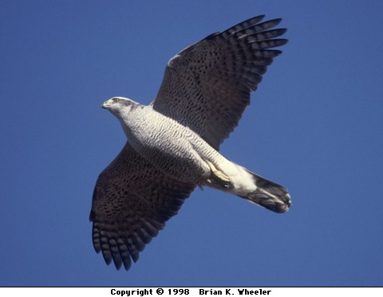
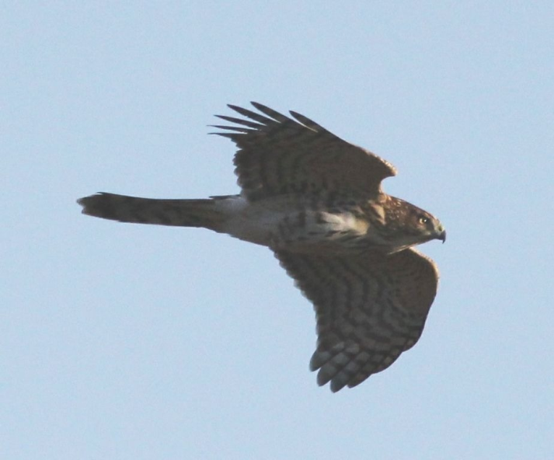
Northern Goshawk
largest Accipiter
Short-ish (comparatively),
rounded wings
Long, heavy-looking tail
“Chunky” cylindrical body
Deep, heavy wingbeat
Notes:
No clear pictures of adult Goshawks in flight could be found for this program. Many of the donors of photographs as well as other contacts said, “They’re on us before we know it, and then it’s too late to catch them!”
This is a testament to the fact that Goshawks can cover a lot of distance with each powerful flap of wings. As the late expert hawkwatcher Robert Smart once said, “Sharpies fly ‘flippy flippy flippy ---- glide. Coops fly ‘flappa flappa flappa ----gli-i-de.’ And Goshawks fly ‘FLOMpa FLOMpa FLOMpa gli-i-i-ide.’”

Slide 13
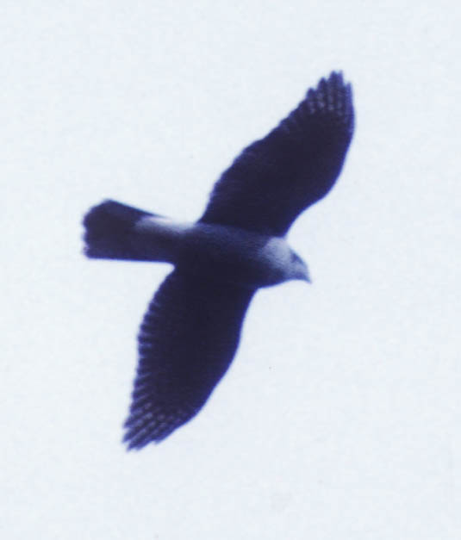
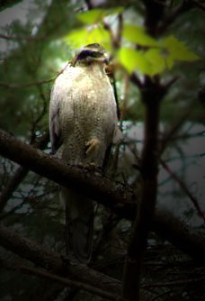
Sometimes the distinctive
dark “eye-stripe” and white
“eyebrow” (superciliary line)
can be seen if the bird is
close enough
Notes:
No field marks visible on this “blown-up” shot of an overhead Gos, and yes, that shot does look fuzzy. This is a good example of exactly how one might see this species in migration, and why knowledge/familiarity with shape and behavior is so important.

Slide 14
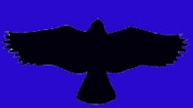
Buteos
are soaring hawks
Designed to utilize air currents
to minimize flapping
Generally found in more open areas
Characterized by long, wide wings and
relatively short broad tail
Perfect form for utilizing updrafts and thermals

Slide 15
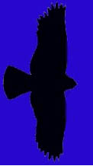
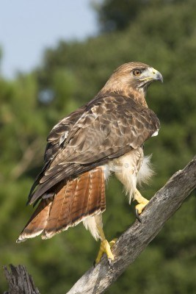
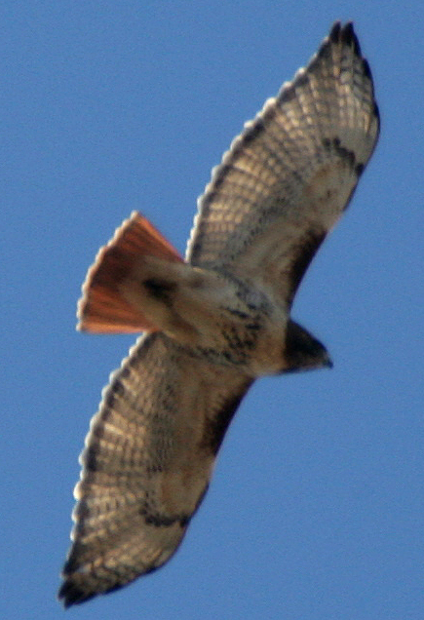
The Quintessential Buteo:
Red-tailed Hawk

Slide 16
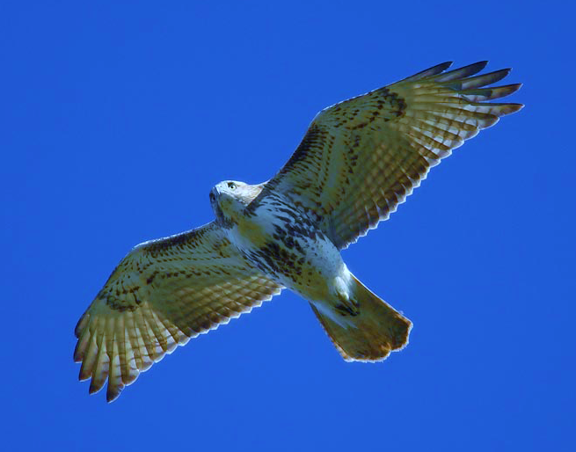
Red-tailed Hawk
Comma
Square-ish wing tips
Belly band
Adults have
brick red tail
Juveniles’ tails
are faintly barred
and brown
Dark patagial area
Notes:
“Belly band” is noted in this slide, but it is important to know that belly bands on Red-tailed Hawks can vary from very dark and dense to only a few barely discernable speckles.
This sub-adult Red-tail shows some faint barring in the tail, which is beginning to show the rusty red of an adult. Younger Red-tails exhibit faintly barred brownish tails.

Slide 17
But…
What if I can’t see those markings?

Slide 18
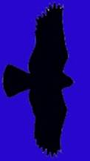
Remember the silhouettes?
And don’t forget behavior…

Slide 19
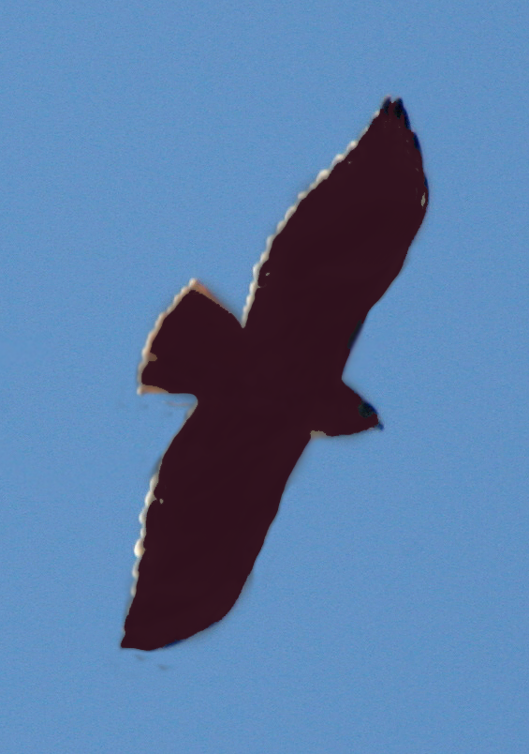
For example, notice on this silhouette:
Red-tailed
“Bulging” secondaries
Relatively short tail

Slide 20
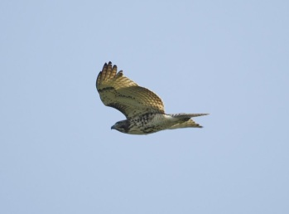
What do you notice about this bird?
It is soaring…
It is a Buteo…
It seems to have bulging secondaries...
Hmmm… its wings seem to be in a slight dihedral (held above horizontal)

Slide 21
This is what a dihedral looks like
when a hawk is coming toward you.
It is also what it looks like when a
hawk is going away from you!

Slide 22
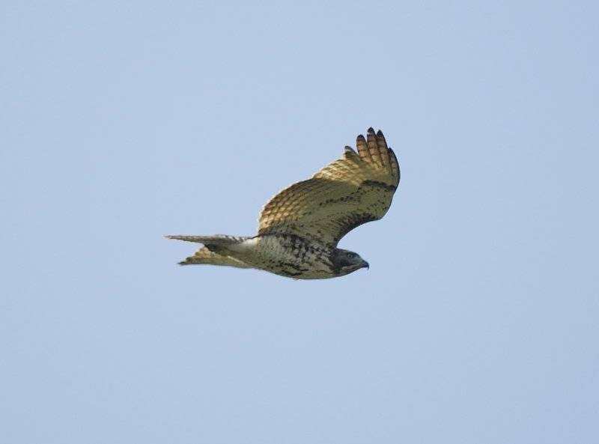
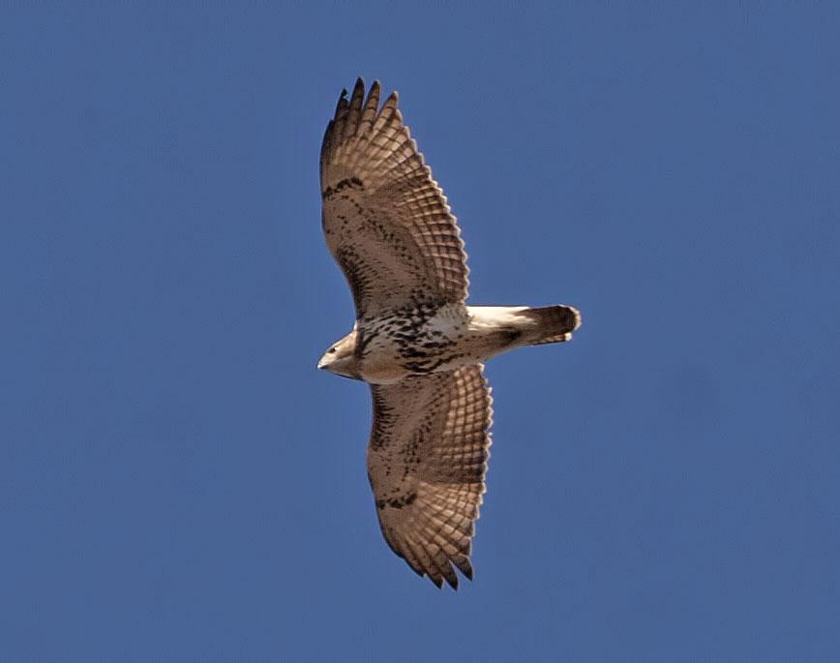
Red-tailed Hawks generally soar with their wings held…
…in a slight dihedral
When Backlit, “windows” can be seen…

Slide 23
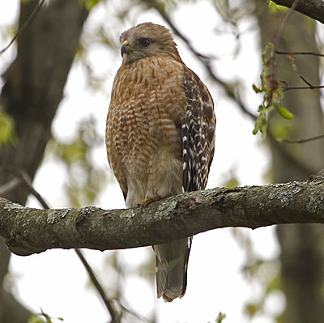
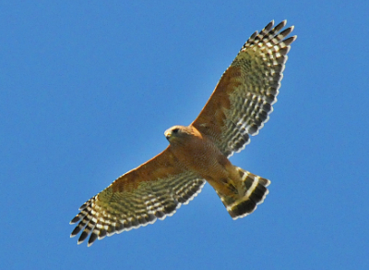
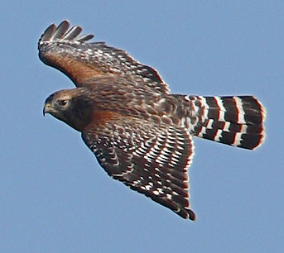
Red-shouldered Hawk
mid-sized Buteo
Flaps wings a bit more
than other Buteos do
Proportionately longer tail
Wings reach forward
while soaring
White “crescents”
along base of primaries
(visible from top or bottom)
Narrow white tail-bands
Notes:
Red-shouldered Hawks seem “hyper” compared to other Buteos. They can sometimes give an Accipiter-like impression because of this behavior and their longer tails. When a Red-shoulder is soaring in an updraft it does indeed flap more and makes frequent wing-adjustments.
The tail appears longer compared to Red-tails. This is because the Red-shoulder’s wings are narrower next to the body than are those of the Red-tail. Seasoned watchers refer to tail-length in terms of its relation to the depth of the wing
1
1.5

Slide 24
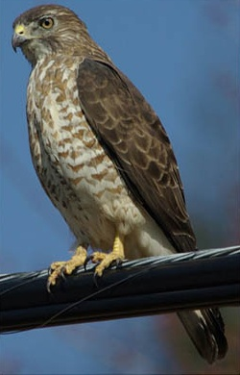
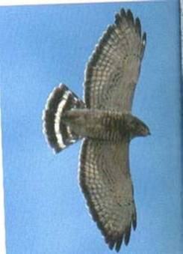
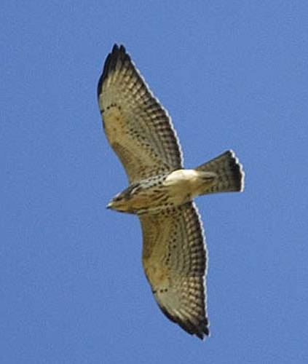
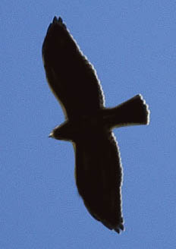
Broad-winged Hawk
Chunky, crow-sized Buteo
“Flame-shaped” wing
held straight out from body
Wide, white tail bands
Pale under-wing with
black trailing edge

Slide 25
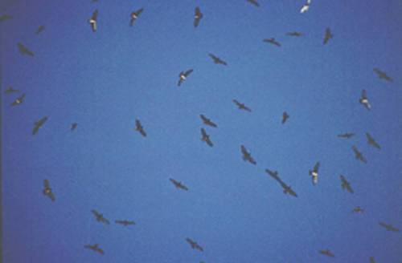
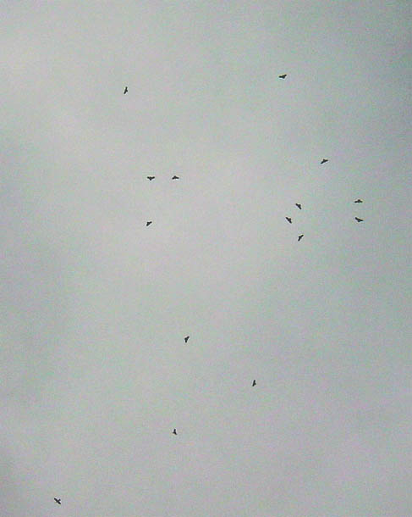
“Kettles” during migration

Slide 26
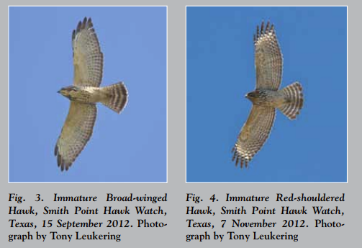
Immature Broad-winged Hawk
vs
Immature Red-shouldered Hawk
Notice the pale mid-throat on Broad-winged
Thinner white tail bands on Red-shouldered

Slide 27
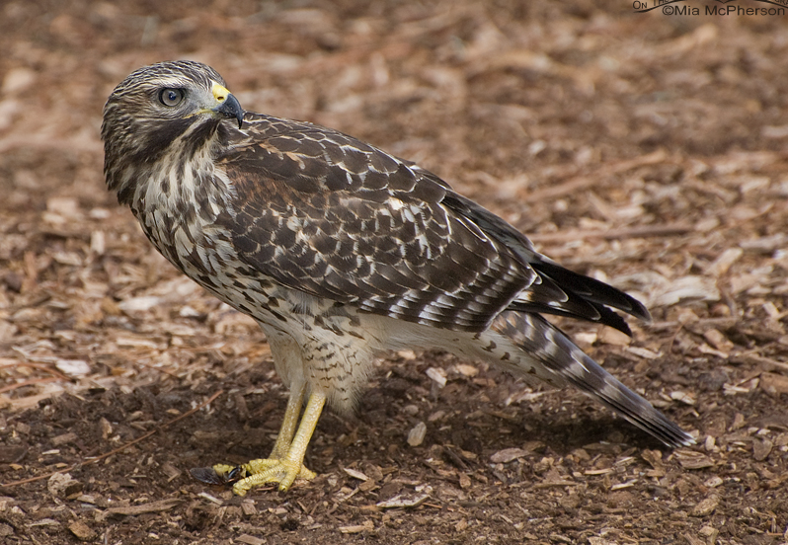
Comparison continued
Broad-winged has pretty even colored secondaries
Red-shouldered has some “white-barring”

Slide 28
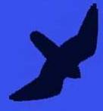
Falcons
are fast-moving raptors
Have a “sickle” shape
Long pointed wings
Long-ish tail
Rarely soar
(Peregrines and Kestrels sometimes do in migration)

Slide 29
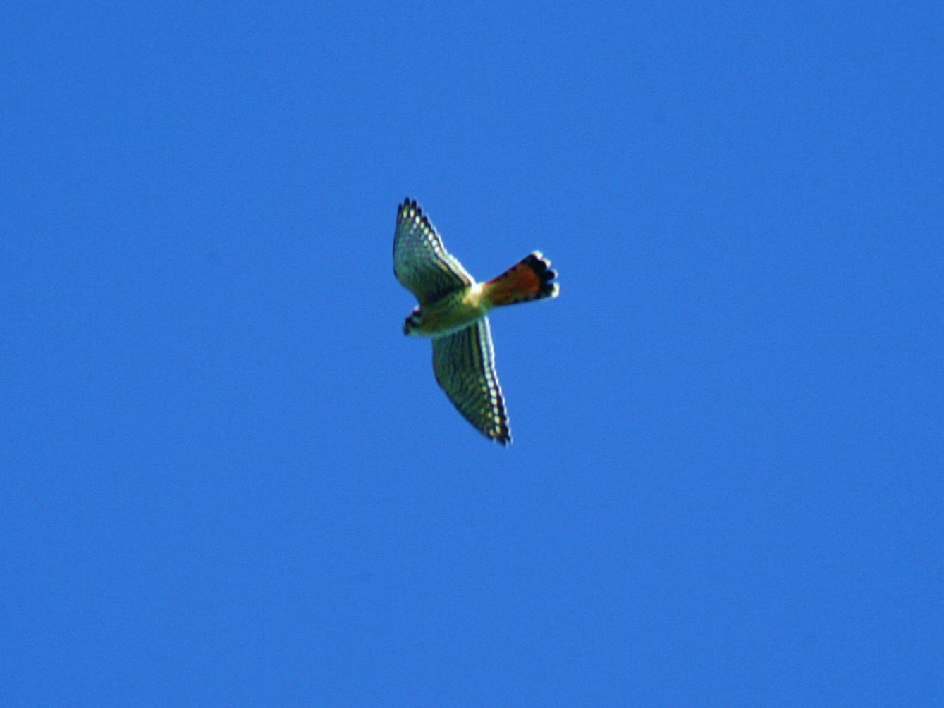

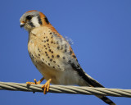
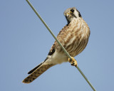
American Kestrel
our smallest falcon
Males
and Females
are dimorphic (differ in plumage)

Slide 30
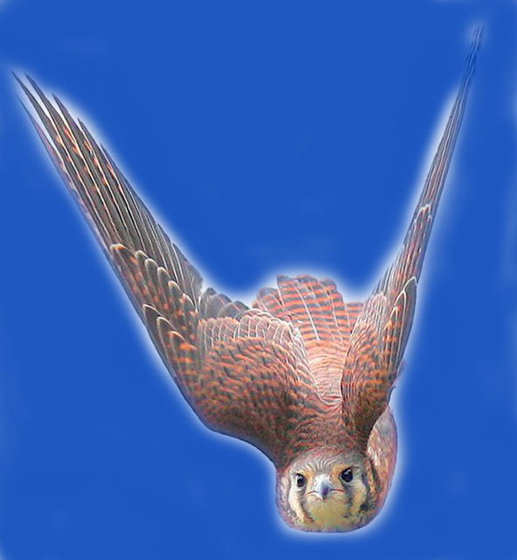
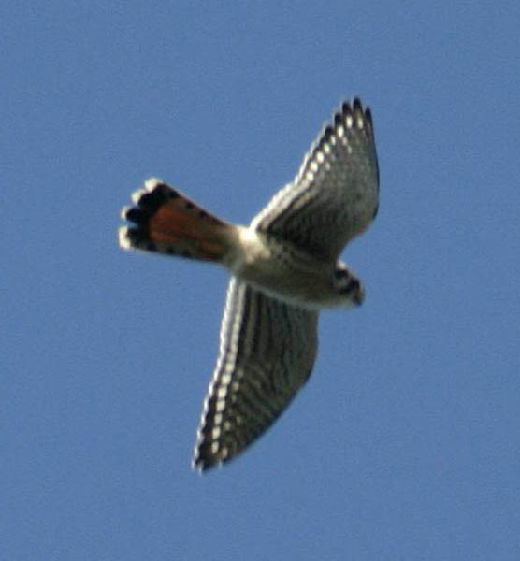
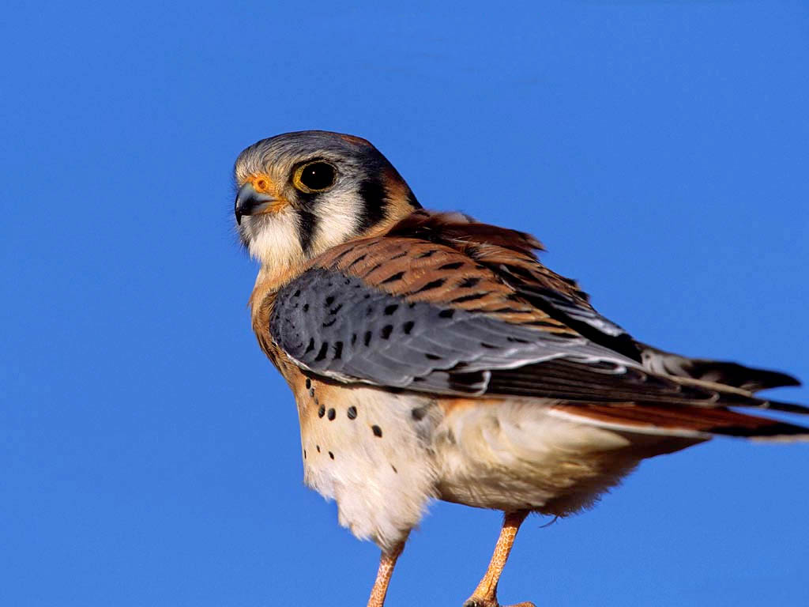
Female
Has a more subtle rufous back
And numerous narrow bands in tail
Male
Has bright rufous
back and blue-ish wings
With a single dark band at end of tail

Slide 31
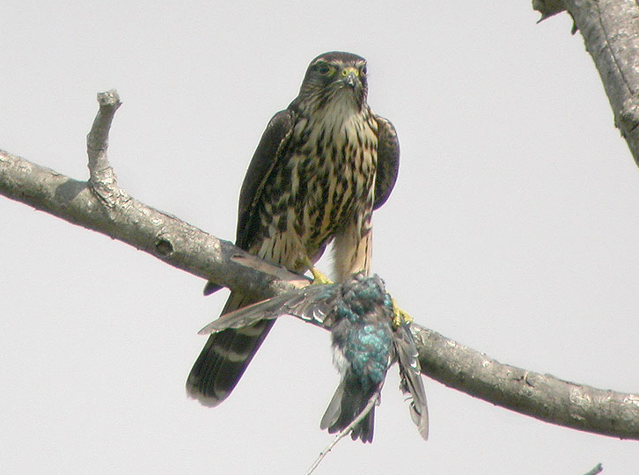
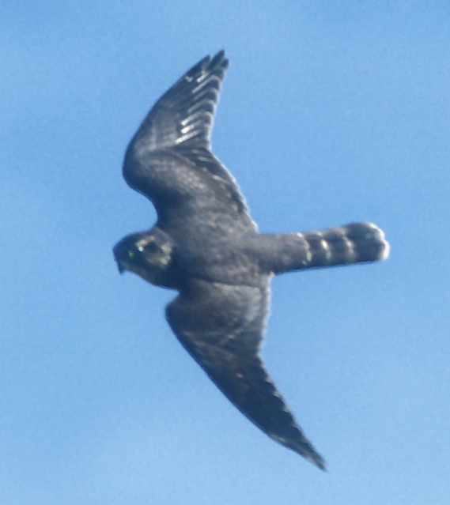
Merlin
Just a little bigger than the Kestrel
A small, FAST falcon…
Powerful, flapping flight
Shallower and faster than the Kestrel

Slide 32
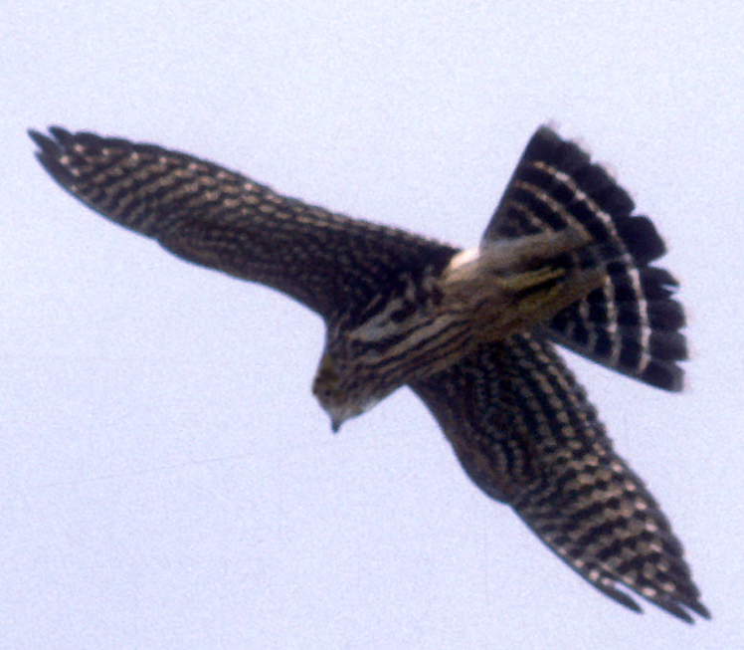

Wider wings than American Kestrel
Merlins have dark plumage
Like the Kestrel, they are
dimorphic
Males are dark grey
Females and young are
heavily streaked and
chocolate brown
(Note the Checkerboard pattern)

Slide 33


Peregrine Falcon
a larger falcon
Very long, pointed wings
Powerful, deep flaps
Fast flight

Slide 34



White upper breast
and throat…
…can usually be seen in flight
Dark cheek (moustachial) patch

Slide 35

Eagles
Very large soaring birds
With 6–7 foot wingspans

Slide 36

Bald Eagle

Slide 37



Large protruding head and bill
Long straight wings held flat when soaring

Slide 38



Immature Bald Eagles
Are brown and can
cause confusion with
other large birds…
It takes 5 years to reach
adult plumage
White can be anywhere,
mottled and blotchy
  White in ‘wingpit’ area
Also, on belly and along line of wing

Slide 39


Golden Eagle
Large, dark soaring bird

Slide 40

Golden Eagle
Smaller head
projection than
Bald Eagle
Tail appears
longer
Has a touch of
secondary bulge
Holds wings flat
or at a moderate
dihedral
Maintains a
steady flight

Slide 41

Golden Eagles
Have “golden” feathers on the nape
Note: long-ish tail
and relatively small head

Slide 42

Immature Golden Eagles
Have white patches typically restricted to base of tail and center of wing

Slide 43


Osprey
A very distinctive shape
A
shaped profile
White belly and head
Dark carpal (“wrist”) patches
Dark eye-line

Slide 44



Females have “necklaces”
Ospreys always show a crook in the wing
This is a male
Notes:
There actually is some overlap in the amount of “necklace” streaking. However, birds with heavier streaking are usually females, and birds with none are males. (Clark and Wheeler, 2001)

Slide 45


Northern Harrier
Long narrow wings
3-4 ft wingspan
Long tail
Slender body
Distinct dihedral
Clear rectangular
white rump patch
*Note: Other raptors
will also appear to have a
white rump depending on Sun
angle

Slide 46



Females have belly streaking and young birds are “buffy looking”
Both are brownish…
Adult males are silvery:
Grey above and white-ish
below with black wing tips
“Grey Ghost”
Notes:
Female underparts are heavily streaked, whereas streaking on young birds is limited to upper breast and flanks.

Slide 47


Both genders display
the white rectangular
rump patch…

Slide 48


Rough-legged Hawk
Long winged Buteo from the north
Dark and Light morphs
Light morphs show a:
Dark belly and
Dark wrist (carpal) patch
Broad white sub-terminal tail band
(Both morphs)

Slide 49















2
1
3
Final exam time!
4
5
6
7
8
9
10

Slide 50





The Answers:
Red-shouldered Hawk
Black Vulture
Osprey
American Kestrel
Bald Eagle (immature)
Peregrine Falcon
Sharp-shinned Hawk
Red-tailed Hawk
Cooper’s Hawk
Broad-winged Hawk

Slide 51
Caveats
Keep the following in mind:
Birds change shape depending upon winds, light and the angle of view

Slide 52


A falcon in a glide may spread its tail to soar on a thermal

Slide 53


A buteo straight overhead make look very different when seen at an angle

Slide 54
A Few Final Points
Nobody is right 100% of the time
For every rule, there is an exception
(e.g. A Sharp-shinned hawk with a rounded tail)
Every bird teaches something –
Once you’ve ID’ed it, stay with it, see how it moves, changes shape, how it looks at different angles

Slide 55
Raptor Web Site Resources
Hawk Migration Association of North America (HMANA):
www.hmana.org
Raptor Population Index:
rpi-project.org
Hawk Counts:
hawkcount.org
This Presentation:
wvbirder.org/recent/RaptorsMontaineer_V7.pptx

Slide 56

Raptor Migration
Map:
e.g. Broad-winged Hawk
Spring:
March-May
Fall:
mid-August to early October
mid-Atlantic peak: Sept 15-20
95% pass in a two week period
Only 12% are found alone
Raptor Peak Times (Fall – mid Atlantic):
Sept - Osprey
Bald Eagle
Broad-winged Hawk (mid)
American Kestrel (late)
Oct – Northern Harrier
Sharp-shinned Hawk (early)
Peregrine Falcon (early)
Merlin (early)
Red-shouldered Hawk (mid)
Cooper’s Hawk (mid)
Nov – Golden Eagle
Bald Eagle
Northern Goshawk
Red-tailed Hawk (early)
Notes:
Most beginning hawkwatchers rely heavily on the standard field guides to bird identification. However, field marks such as color and wing markings are not always viewable on hawks passing a watchsite. This can be a result of many factors such as distance, bright sky, and backlighting.
In this program field marks will be referred to from time to time, but our main intent is to familiarize the viewer with the more “gestalt” aspects of raptor identification. The purpose of the field mark slides is to show any aspects of a bird that might be seen which would add a degree of confidence to an identification

Slide 57

Hawk Watching Sites
Data from: Hawkcount.org
Waggoner’s Gap – Near Carlise, PA
Notes:
Most beginning hawkwatchers rely heavily on the standard field guides to bird identification. However, field marks such as color and wing markings are not always viewable on hawks passing a watchsite. This can be a result of many factors such as distance, bright sky, and backlighting.
In this program field marks will be referred to from time to time, but our main intent is to familiarize the viewer with the more “gestalt” aspects of raptor identification. The purpose of the field mark slides is to show any aspects of a bird that might be seen which would add a degree of confidence to an identification

