Slide 1
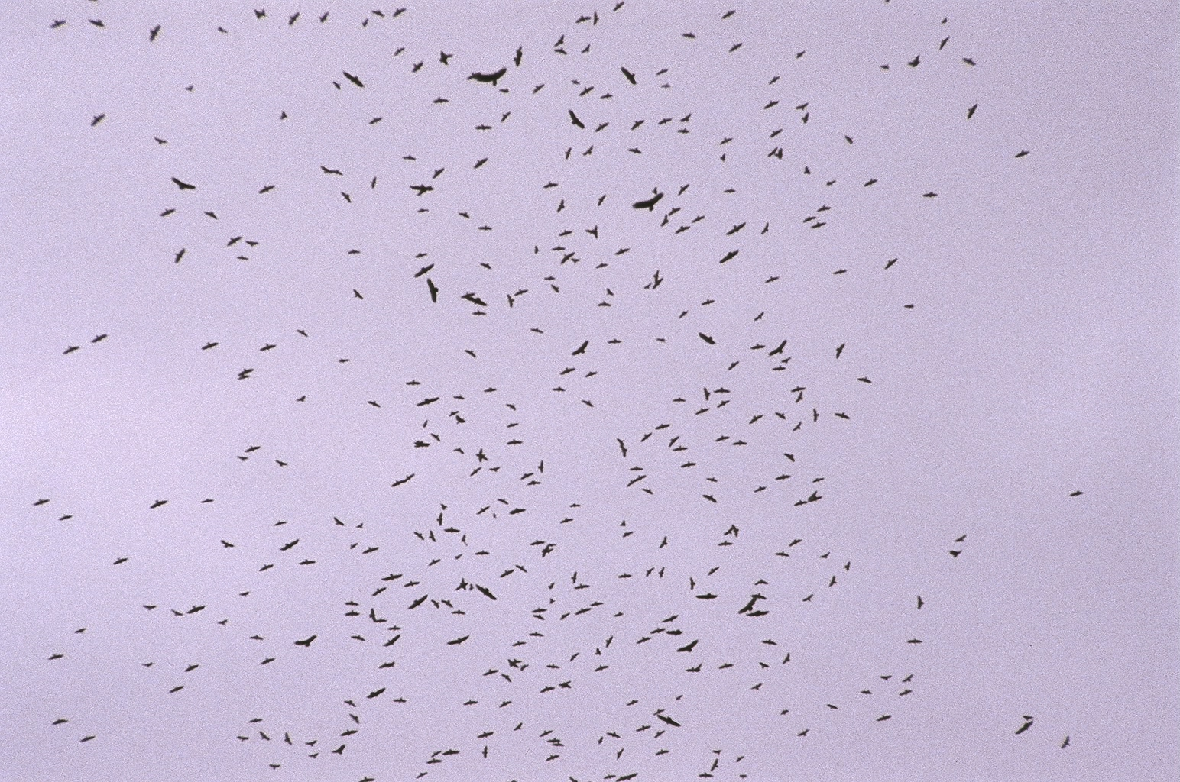
Potomac Valley Audubon
Raptor Identification
In Flight
Presented by Matt Orsie

Slide 2
Identification
How can you know what you are seeing?
By Using General Impressions:
  SHAPE
  SIZE
  BEHAVIOR
Notes:
Most beginning hawkwatchers rely heavily on the standard field guides to bird identification. However, field marks such as color and wing markings are not always viewable on hawks passing a watchsite. This can be a result of many factors such as distance, bright sky, and backlighting.
In this program field marks will be referred to from time to time, but our main intent is to familiarize the viewer with the more “gestalt” aspects of raptor identification. The purpose of the field mark slides is to show any aspects of a bird that might be seen which would add a degree of confidence to an identification

Slide 3
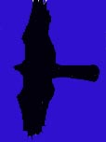
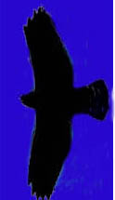
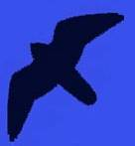

First!
Learn the basic silhouettes/shapes of…
Accipiters
Buteos
Falcons
Eagles

Slide 4
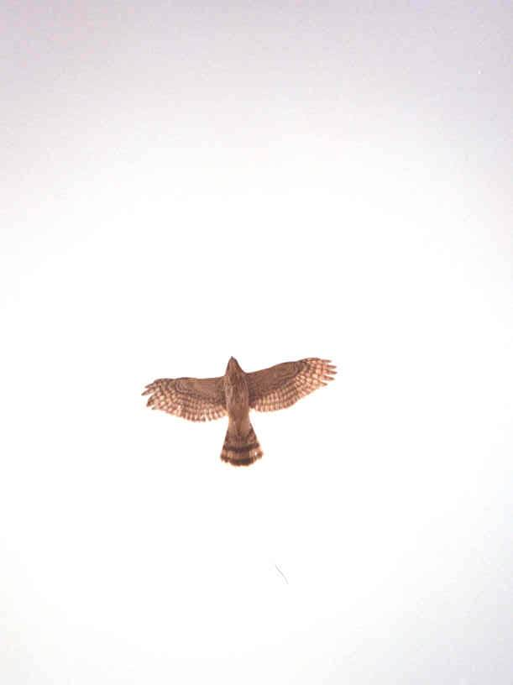
Accipiters
are forest-dwelling hawks
Built for rapid flight and lightning quick turns in wooded habitats
Characterized by short, rounded wings and long, narrow tail
In migration or in open habitat they exhibit intermittent flapping and gliding flight

Slide 5
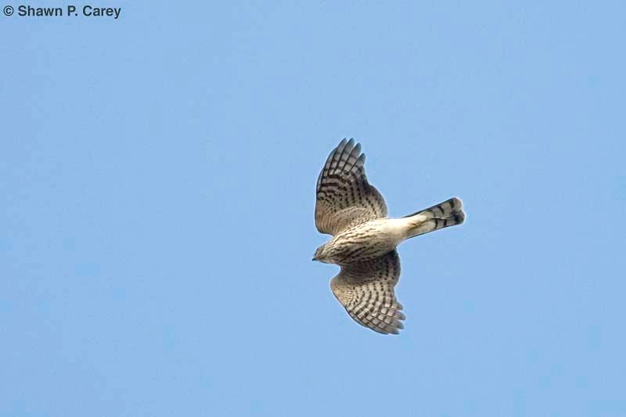
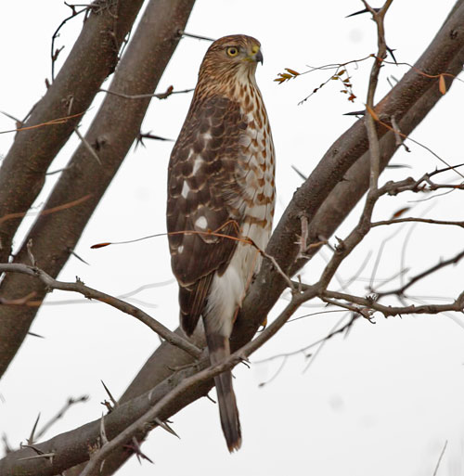
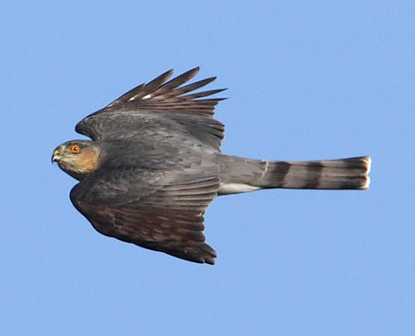
Sharp-shinned Hawk
the smallest Accipiter
Blue Jay sized
Small-ish head
barely projects
beyond “wrists”
Short, rounded wings
Tail usually appears
square-ish, sometimes
with a notch

Slide 6
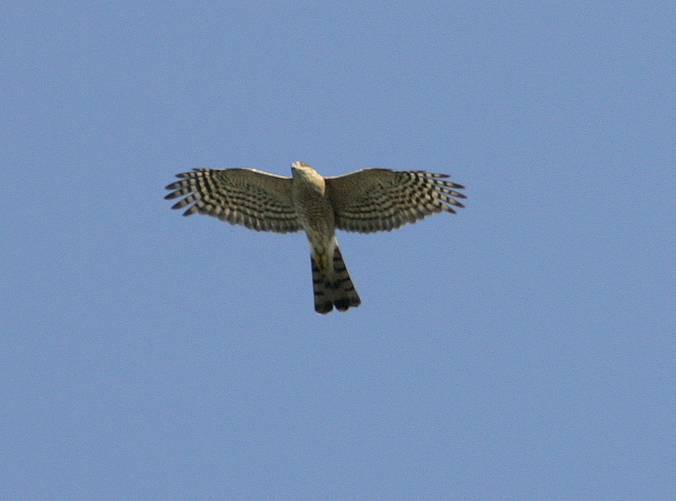
Wingbeat:
Snappy
Deep
Rapid (hard to count)

Slide 7
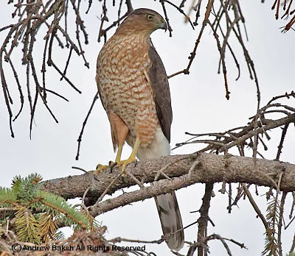
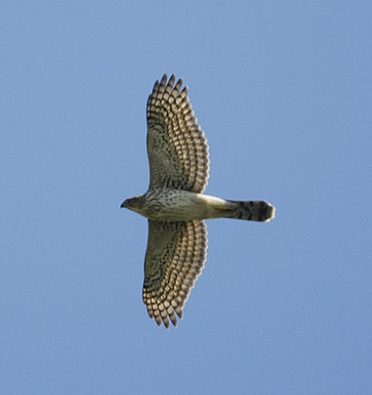
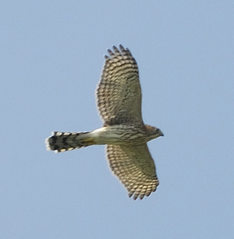
Cooper’s Hawk
medium-sized Accipiter
Short-ish, rounded wings
Straight leading edge of
wing
Protruding head
Long, usually rounded tail
Notes:
The Cooper’s Hawk pictured here is an immature. Adults have rust-colored barred underparts.

Slide 8
Wingbeat:
Stiff
Shallow
Slower
(than Sharp-shinned)

Slide 9
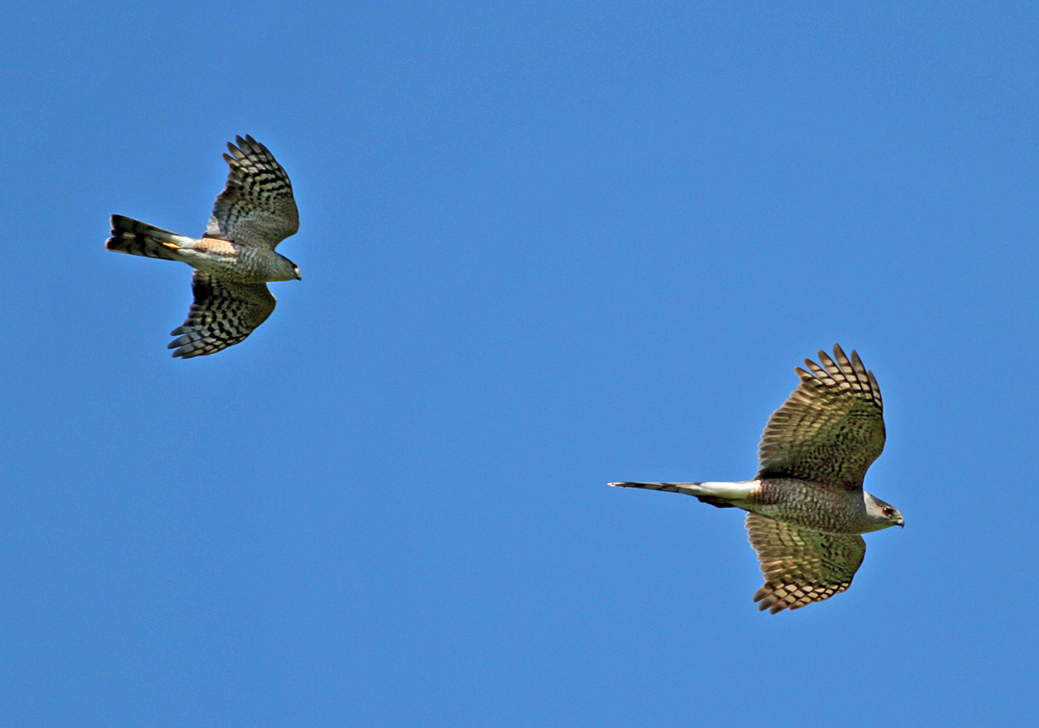
Cooper’s has a “longer body length look”
than the Sharp-shinned
Sharp-shinned
Cooper’s
Small head
Protruding
head
Square-ish tail,
(sometimes notched)
Rounded tail
A flying “T”
A flying Cross
Jay McGowan
Notes:
Both of these birds are immatures.

Slide 10
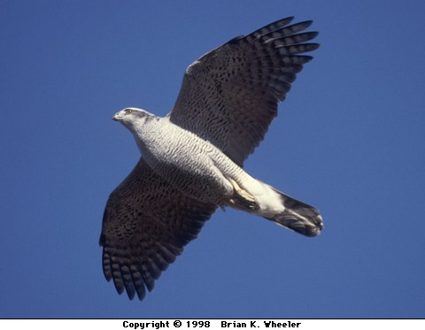
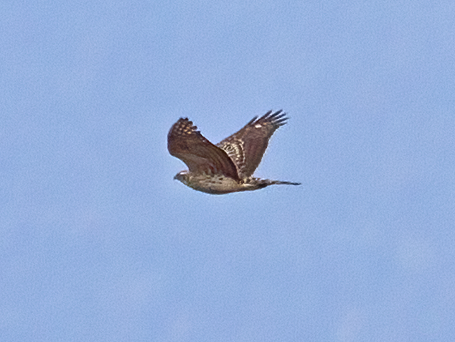
Northern Goshawk
largest Accipiter
Supercilium visible from a distance
Short-ish (comparatively),
rounded wings
Long, heavy-looking tail
“Chunky” cylindrical body
Deep, heavy wingbeat
Notes:
No clear pictures of adult Goshawks in flight could be found for this program. Many of the donors of photographs as well as other contacts said, “They’re on us before we know it, and then it’s too late to catch them!”
This is a testament to the fact that Goshawks can cover a lot of distance with each powerful flap of wings. As the late expert hawkwatcher Robert Smart once said, “Sharpies fly ‘flippy flippy flippy ---- glide. Coops fly ‘flappa flappa flappa ----gli-i-de.’ And Goshawks fly ‘FLOMpa FLOMpa FLOMpa gli-i-i-ide.’”

Slide 11
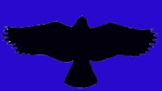
Buteos
are soaring hawks
Designed to utilize air currents
to minimize flapping
Generally found in more open areas
Characterized by long, wide wings and
relatively short broad tail
Perfect form for utilizing updrafts and thermals

Slide 12
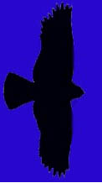
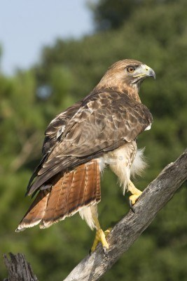
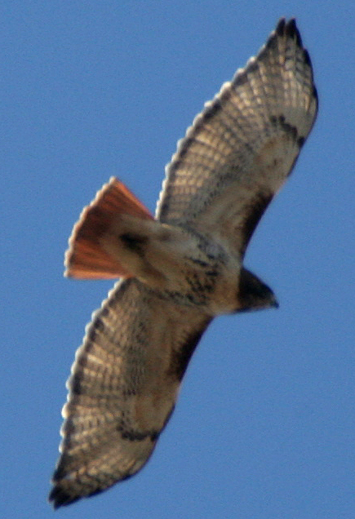
The Quintessential Buteo:
Red-tailed Hawk

Slide 13
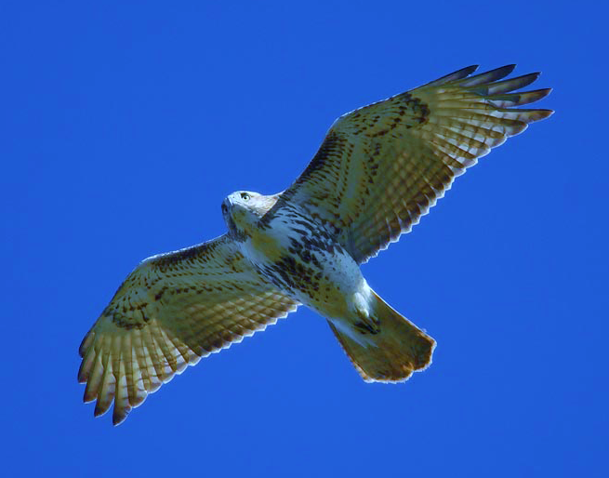
Red-tailed Hawk
Comma
Square-ish wing tips
Belly band
Adults have
brick red tail
Juveniles’ tails
are faintly barred
and brown
Dark patagial area
Notes:
“Belly band” is noted in this slide, but it is important to know that belly bands on Red-tailed Hawks can vary from very dark and dense to only a few barely discernable speckles.
This sub-adult Red-tail shows some faint barring in the tail, which is beginning to show the rusty red of an adult. Younger Red-tails exhibit faintly barred brownish tails.

Slide 14
But…
What if I can’t see those markings?

Slide 15
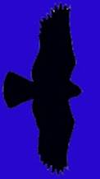
Remember the silhouettes?
And don’t forget behavior…

Slide 16
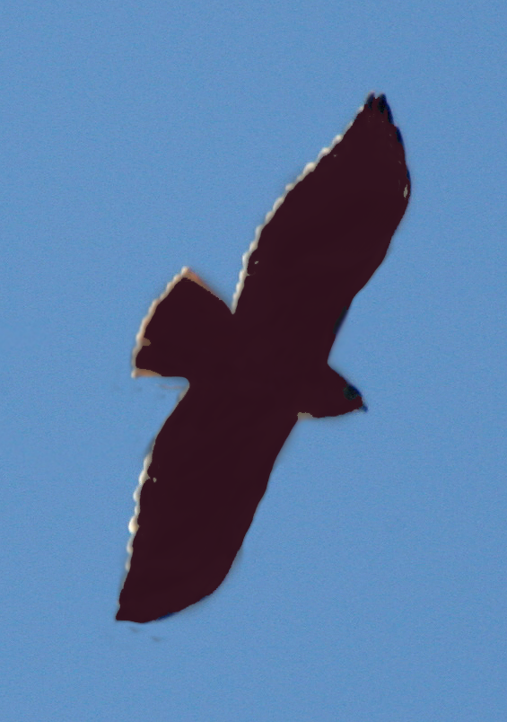
For example, notice on this silhouette:
Red-tailed
“Bulging” secondaries
Relatively short tail

Slide 17
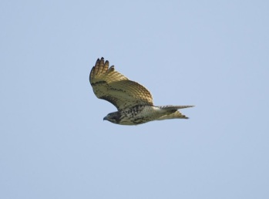
What do you notice about this bird?
It is soaring…
It is a Buteo…
It seems to have bulging secondaries...
Hmmm… its wings seem to be in a slight dihedral (held above horizontal)

Slide 18
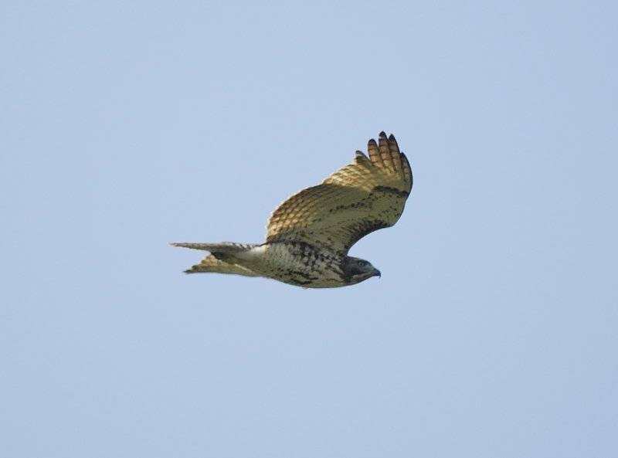
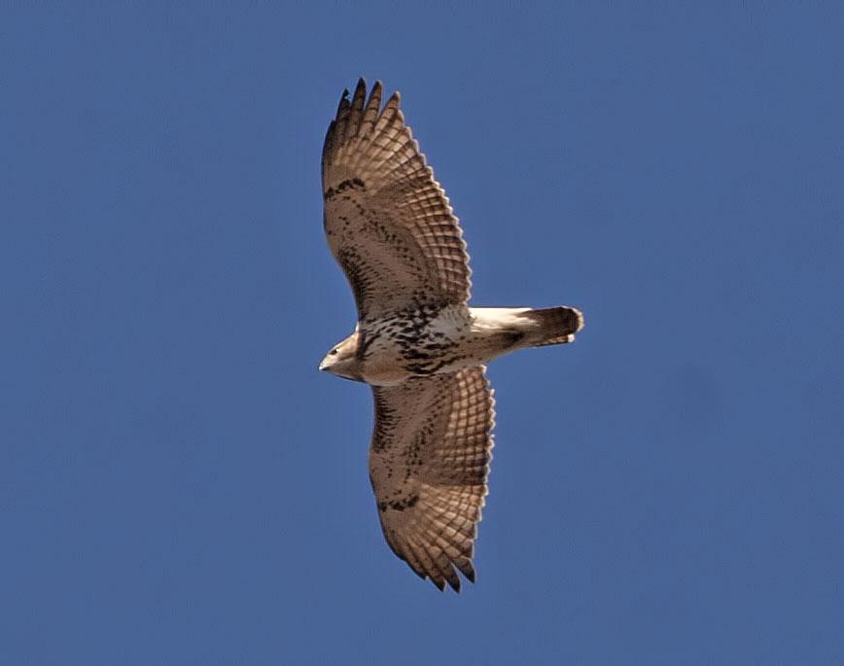
Red-tailed Hawks generally soar with their wings held…
…in a slight dihedral
When Backlit, “squar-ish windows” can be seen…

Slide 19
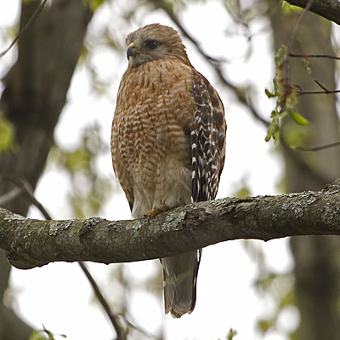
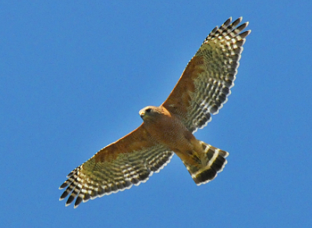
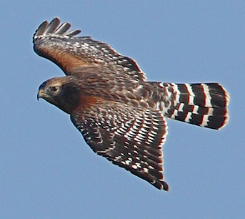
Red-shouldered Hawk
mid-sized Buteo
Flaps wings a bit more
than other Buteos do
Proportionately longer tail
Wings reach forward
while soaring
White “crescents”
along base of primaries
(visible from top or bottom)
Narrow white tail-bands
Notes:
Red-shouldered Hawks seem “hyper” compared to other Buteos. They can sometimes give an Accipiter-like impression because of this behavior and their longer tails. When a Red-shoulder is soaring in an updraft it does indeed flap more and makes frequent wing-adjustments.
The tail appears longer compared to Red-tails. This is because the Red-shoulder’s wings are narrower next to the body than are those of the Red-tail. Seasoned watchers refer to tail-length in terms of its relation to the depth of the wing
1
1.5

Slide 20
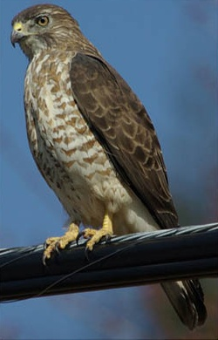
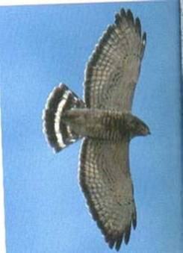
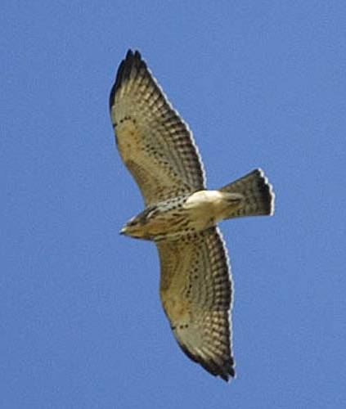
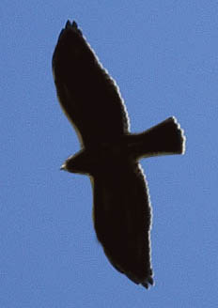
Broad-winged Hawk
Chunky, crow-sized Buteo
“Flame-shaped” wing
held straight out from body
Wide, black tail bands
Pale under-wing with
black trailing edge

Slide 21
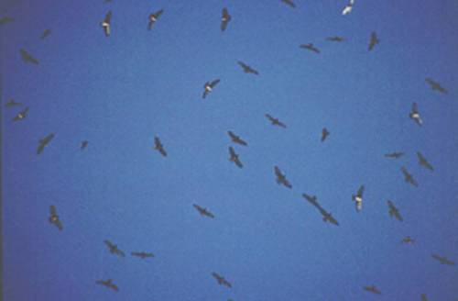
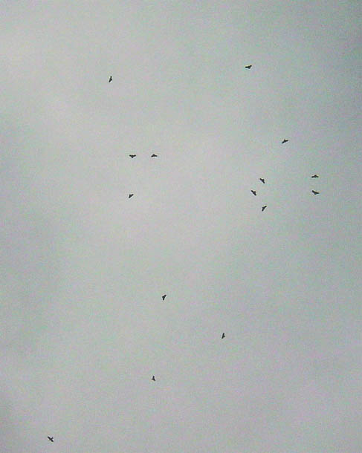
“Kettles” during migration

Slide 22
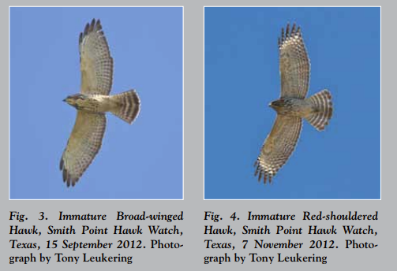
Immature Broad-winged Hawk
vs
Immature Red-shouldered Hawk
Notice the pale mid-throat on Broad-winged
Thinner white tail bands on Red-shouldered

Slide 23
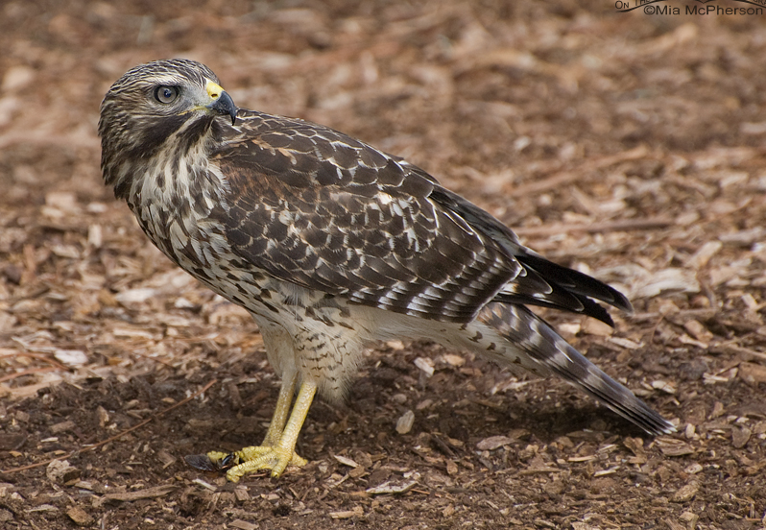
Comparison continued…
Broad-winged has pretty even colored secondaries
Red-shouldered has some “white-barring”

Slide 24
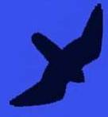
Falcons
are fast-moving raptors
Have a “sickle” shape
Long pointed wings
Long-ish tail
Rarely soar
(Peregrines and Kestrels sometimes do in migration)

Slide 25
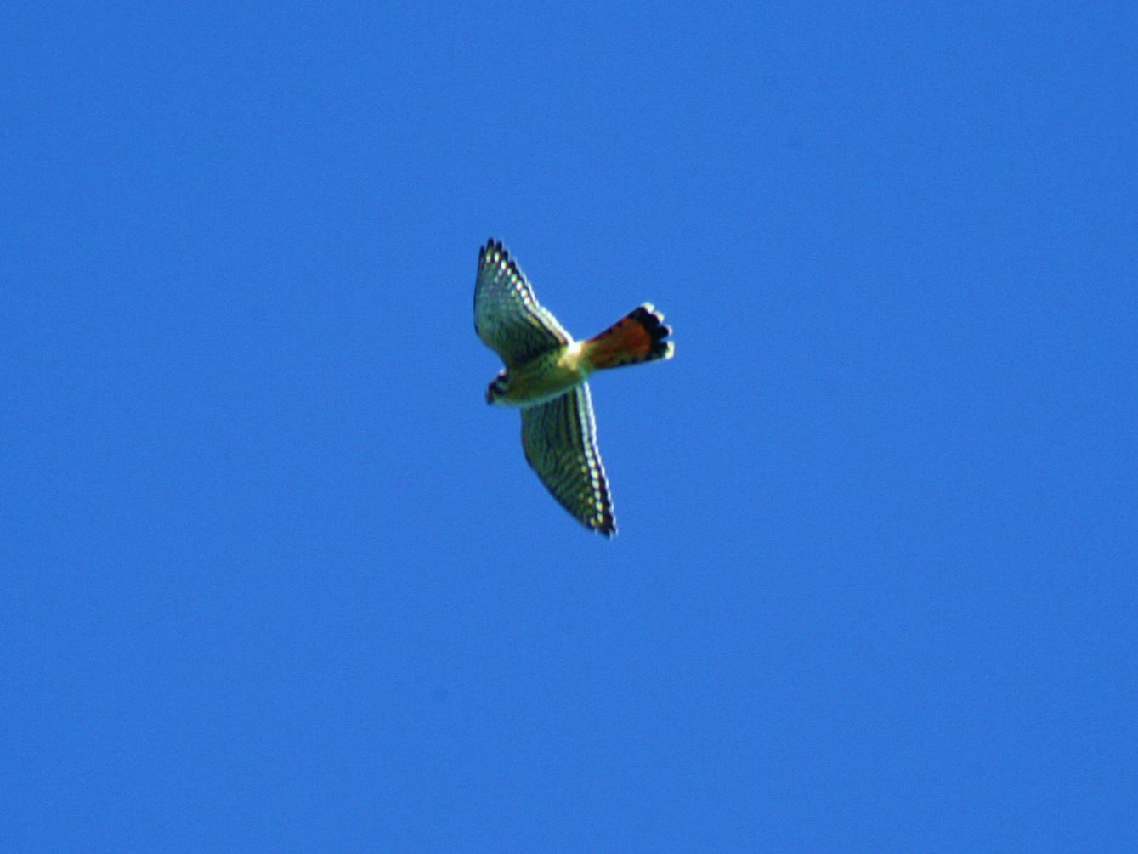

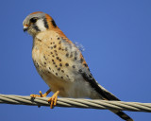
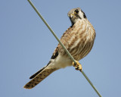
American Kestrel
our smallest falcon
Males
and Females
are dimorphic (differ in plumage)

Slide 26
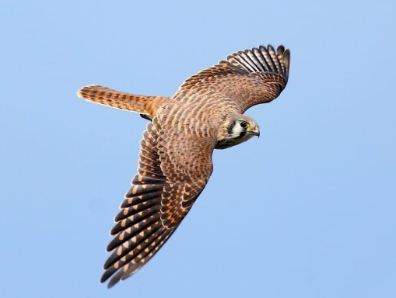
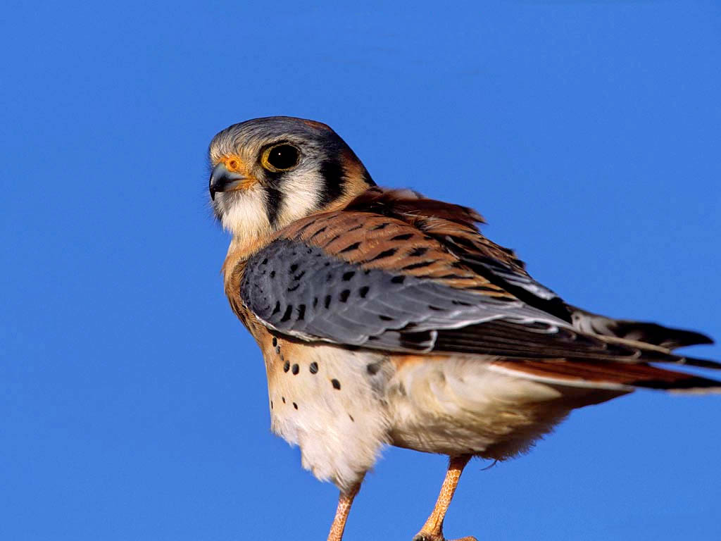
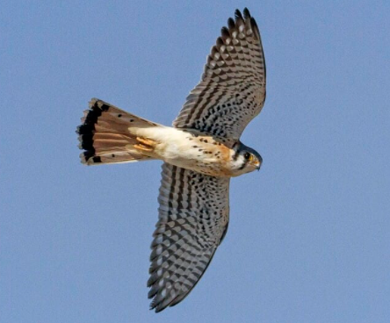
Female
Has a more subtle rufous back
Male
Has bright rufous
back and blue-ish wings
And numerous narrow bands in tail
With a single dark band at end of tail

Slide 27
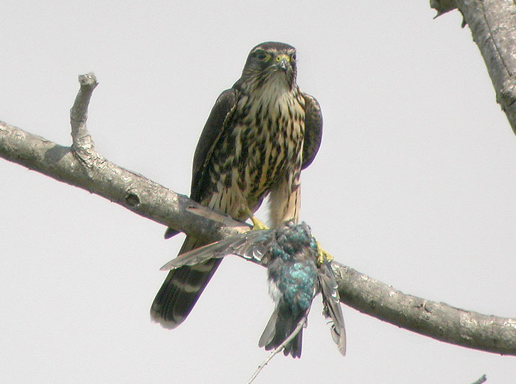
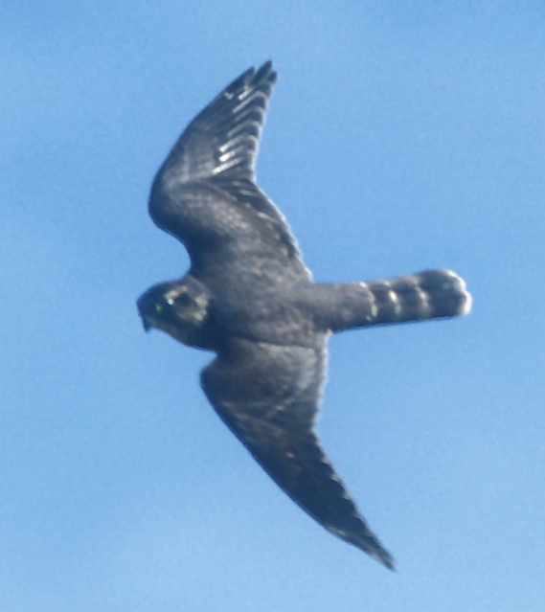
Merlin
Just a little bigger than the Kestrel
A small, FAST falcon…
Powerful, flapping flight
Shallower and faster than the Kestrel

Slide 28
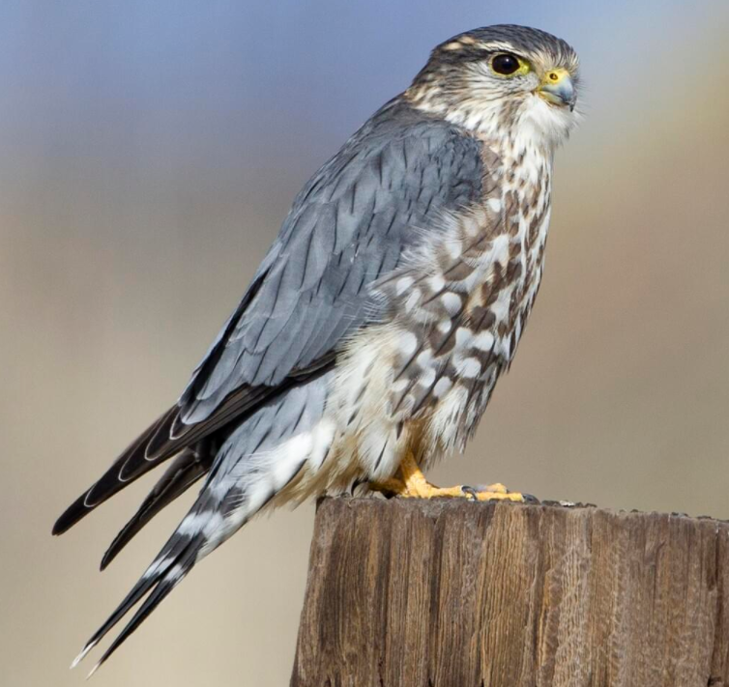
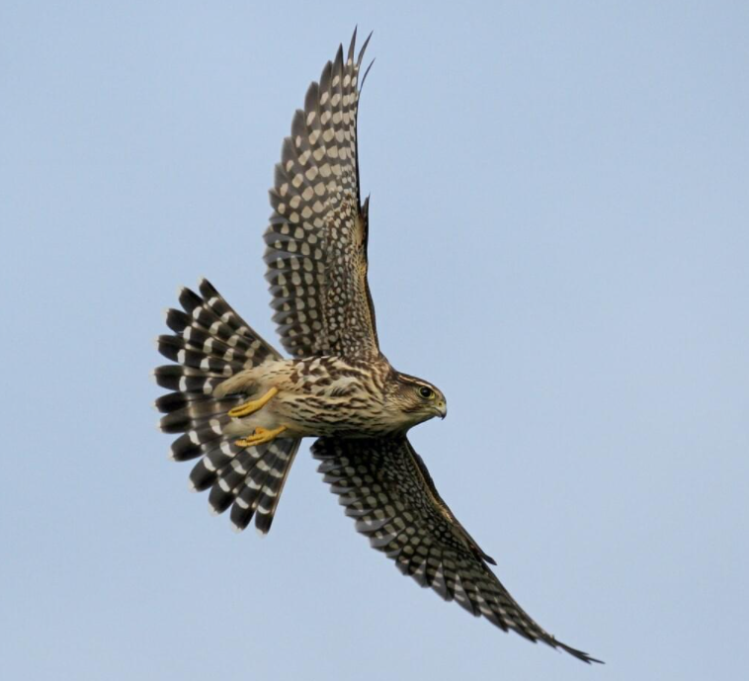
Merlins have dark plumage
Like the Kestrel, they are
dimorphic
Males are dark grey
Wider wings than American
Kestrel
Females and young are
heavily streaked and
chocolate brown
(Note the Checkerboard pattern)

Slide 29
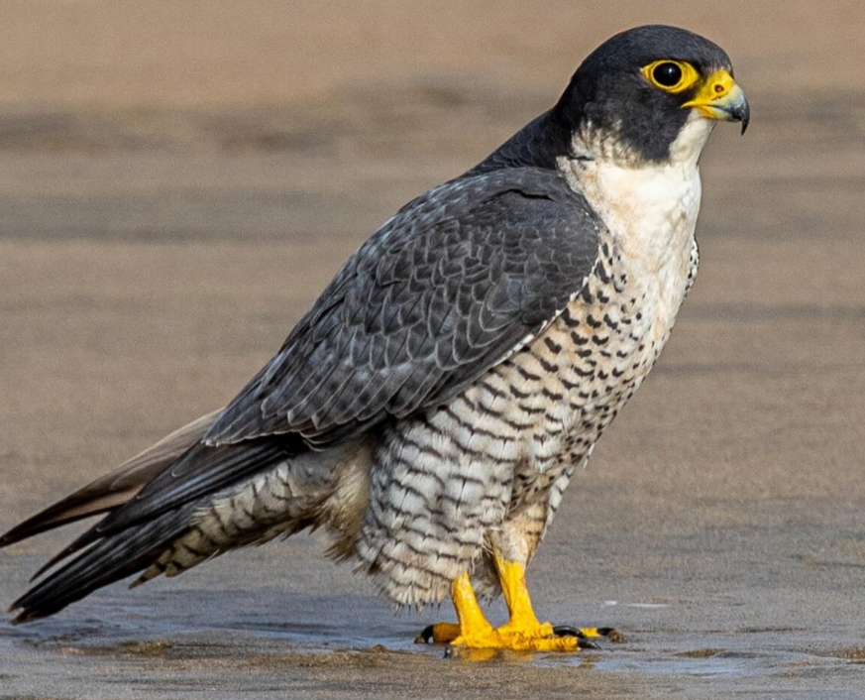
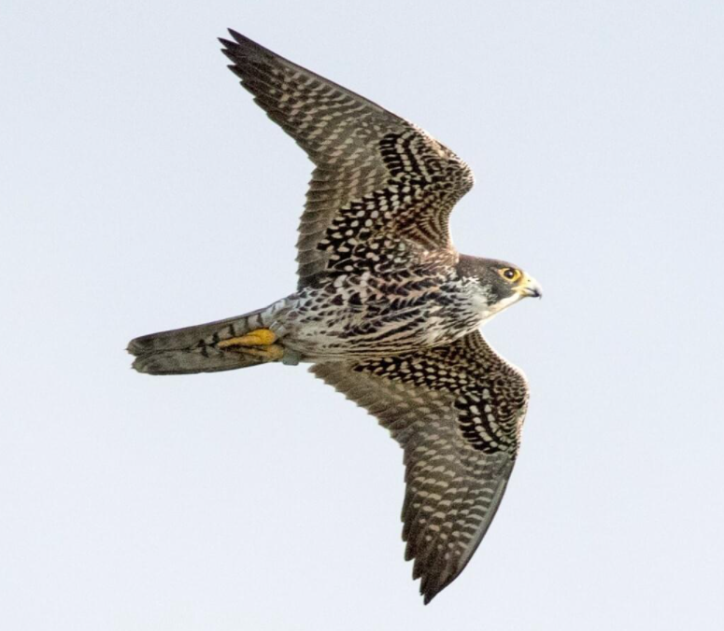
Peregrine Falcon
a larger falcon
Very long, pointed wings
Powerful, deep flaps
Fast flight

Slide 30
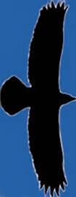
Eagles
Very large soaring birds
With 6–7 foot wingspans

Slide 31

Bald Eagle

Slide 32



Large protruding head and bill
Long straight wings held flat when soaring

Slide 33



Immature Bald Eagles
Are brown and can
cause confusion with
other large birds…
It takes 5 years to reach
adult plumage
White can be anywhere,
mottled and blotchy
  White in ‘wingpit’ area
Also, on belly and along line of wing

Slide 34


Golden Eagle
Large, dark soaring bird
Adult

Slide 35
Golden Eagles
Have “golden” feathers on the nape
Note: long-ish tail
and relatively small head

Slide 36

Immature Golden Eagles
Have white patches typically restricted to base of tail and center of wing

Slide 37


Osprey
A very distinctive shape
A
shaped profile
White belly and head
Dark carpal (“wrist”) patches
Dark eye-line

Slide 38


Females have “necklaces”
or brown patches
Ospreys always show a crook in the wing
This is a male
Notes:
There actually is some overlap in the amount of “necklace” streaking. However, birds with heavier streaking are usually females, and birds with none are males. (Clark and Wheeler, 2001)

Slide 39


Northern Harrier
Long narrow wings
3-4 ft wingspan
Long tail
Slender body
Distinct dihedral
Clear rectangular
white rump patch
*Note: Other raptors
will also appear to have a
white rump depending on Sun
angle

Slide 40



Females have belly streaking and young birds are “buffy looking”
Both are brownish…
Adult males are silvery:
Grey above and white-ish
below with black wing tips
“Grey Ghost”
Notes:
Female underparts are heavily streaked, whereas streaking on young birds is limited to upper breast and flanks.

Slide 41


Both genders display
the white rectangular
rump patch…

Slide 42


Rough-legged Hawk
Long winged Buteo from the north
Dark and Light morphs
Light morphs show a:
Dark belly and
Dark wrist (carpal) patch
Broad white sub-terminal tail band
(Both morphs)

Slide 43
Caveats
Keep the following in mind:
Birds change shape depending upon winds, light and the angle of view

Slide 44


A falcon in a glide may spread its tail to soar on a thermal

Slide 45


A buteo straight overhead make look very different when seen at an angle

Slide 46
A Few Final Points
Nobody is right 100% of the time
For every rule, there is an exception
(e.g. A Sharp-shinned hawk with a rounded tail)
Every bird teaches something –
Once you’ve ID’ed it, stay with it, see how it moves, changes shape, how it looks at different angles

Slide 47
Raptor Web Site Resources
Hawk Migration Association of North America (HMANA):
www.hmana.org
Raptor Population Index: rpi-project.org
Hawk Counts: hawkcount.org
Book Resources
Hawks in Flight: Pete Dunn, David Sibley, Clay Sutton
Hawks from Every Angle: Jerry Liguori
Hawks at a Distance: Jerry Liguori
Apps for Smart Phones
Raptor ID: HawkWatch International
Merlin Bird ID: Cornell Lab

Slide 48
Questions?

Slide 49

Raptor Migration
Map:
e.g. Broad-winged Hawk
Spring:
March-May
Fall:
mid-August to early October
mid-Atlantic peak: Sept 15-20
95% pass in a two week period
Only 12% are found alone
Raptor Peak Times (Fall – mid Atlantic):
Sept - Osprey
Bald Eagle
Broad-winged Hawk (mid)
American Kestrel (late)
Oct – Northern Harrier
Sharp-shinned Hawk (early)
Peregrine Falcon (early)
Merlin (early)
Red-shouldered Hawk (mid)
Cooper’s Hawk (mid)
Nov – Golden Eagle
Bald Eagle
Northern Goshawk
Red-tailed Hawk (early)
Notes:
Most beginning hawkwatchers rely heavily on the standard field guides to bird identification. However, field marks such as color and wing markings are not always viewable on hawks passing a watchsite. This can be a result of many factors such as distance, bright sky, and backlighting.
In this program field marks will be referred to from time to time, but our main intent is to familiarize the viewer with the more “gestalt” aspects of raptor identification. The purpose of the field mark slides is to show any aspects of a bird that might be seen which would add a degree of confidence to an identification

Slide 50

Hawk Watching Sites
Data from: Hawkcount.org
Waggoner’s Gap – Near Carlise, PA
Notes:
Most beginning hawkwatchers rely heavily on the standard field guides to bird identification. However, field marks such as color and wing markings are not always viewable on hawks passing a watchsite. This can be a result of many factors such as distance, bright sky, and backlighting.
In this program field marks will be referred to from time to time, but our main intent is to familiarize the viewer with the more “gestalt” aspects of raptor identification. The purpose of the field mark slides is to show any aspects of a bird that might be seen which would add a degree of confidence to an identification

